Slide 1
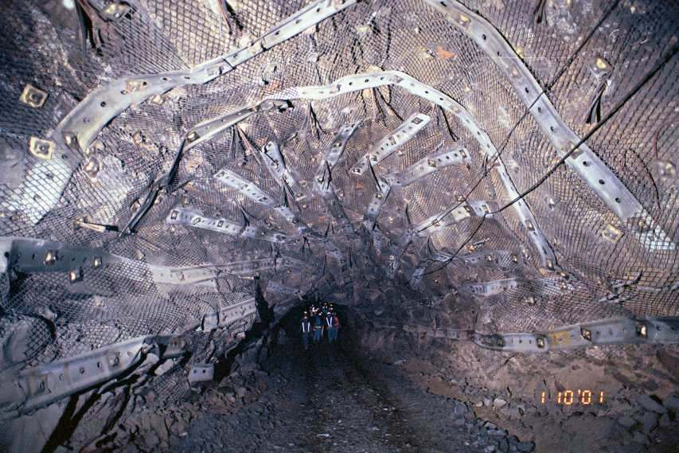
How do you look for WIMPs in the lab?
Location, location, location.
Notes:
ra3h30dec-60, 225 deg2, our largest field from 2009.
alignment 657 331 40 95

Slide 2
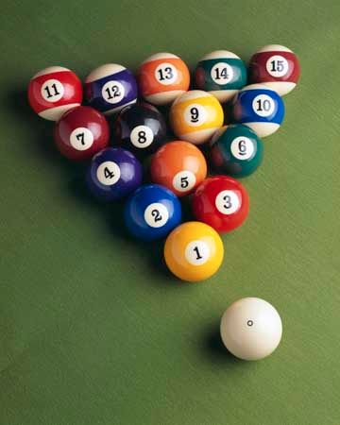
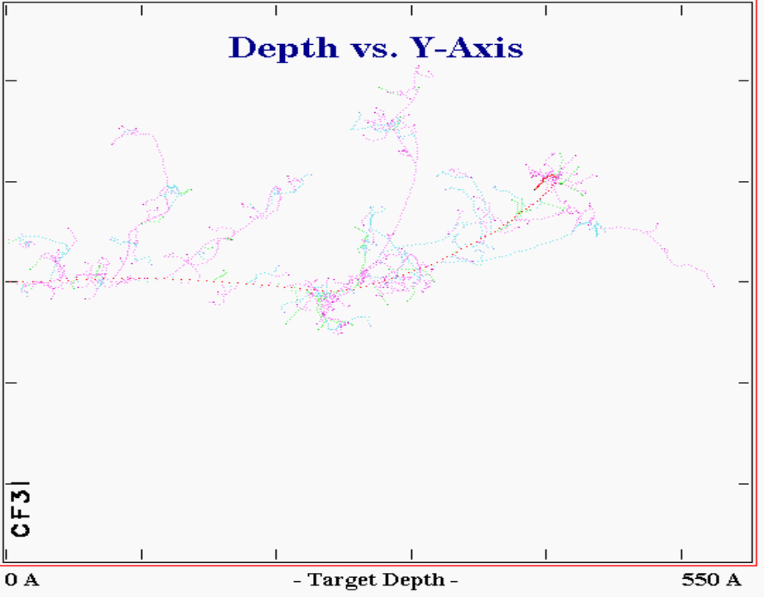
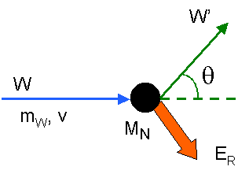
How do you look for WIMPs in the lab?
It’s all a game of billiards, really.
Notes:
ra3h30dec-60, 225 deg2, our largest field from 2009.
alignment 657 331 40 95

Slide 3
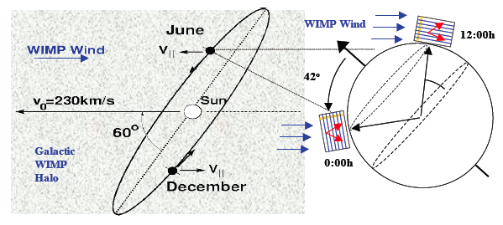
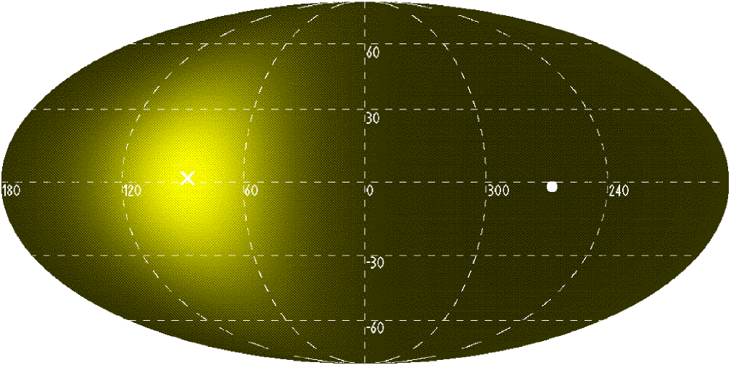
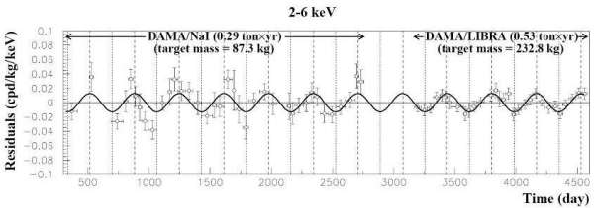
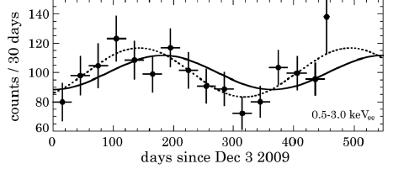
How do you look for WIMPs in the lab?
A “WIMP wind” from Cygnus
Directional detectors,
our holy grail
(but the game has some weird rules)
Notes:
ra3h30dec-60, 225 deg2, our largest field from 2009.
alignment 657 331 40 95

Slide 4
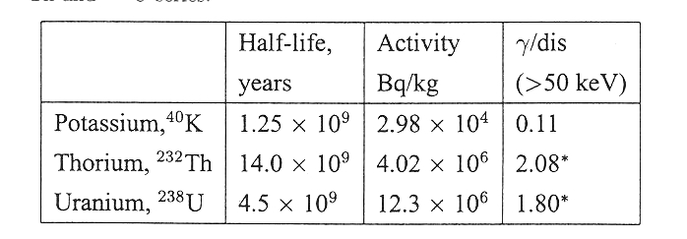
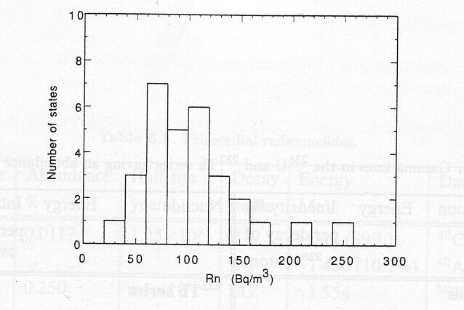
We live in a radioactive medium (and one day, “dark matter” will be regarded as just another form of radiation)
Many sources:
Primordial (U, Th, K)
Cosmogenic
Man-made
Rule-of-thumb: ~1 ppm U and Th in Earth’s crust.
You are what you eat...
Radon in air (yes, this air)
Notes:
Rn Brodzinski (Rn or Po-210)
Lung cancer

Slide 5
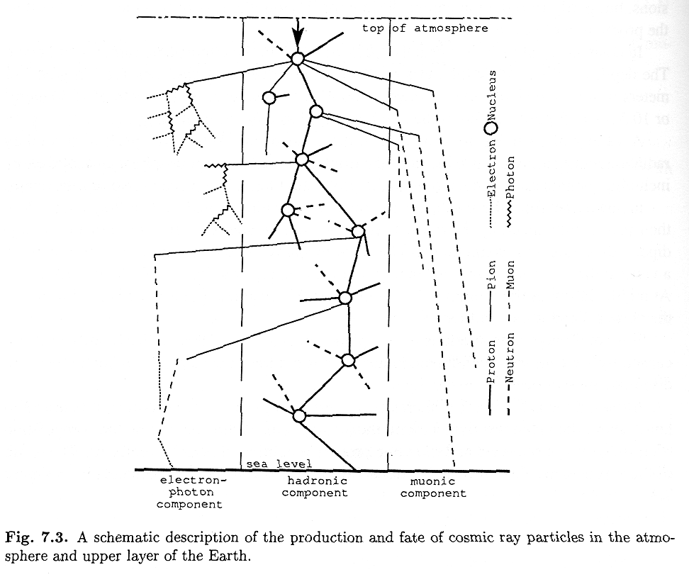
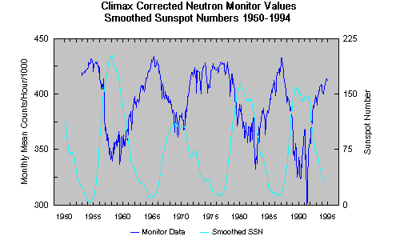
We live in a radioactive medium (and one day, “dark matter” will be regarded as just another form of radiation)
Many sources:
Primordial (U, Th, K)
Cosmogenic
Man-made
Don’t look up now…
The Sun, doing its bit to help
Notes:
Rn Brodzinski (Rn or Po-210)
Lung cancer

Slide 6
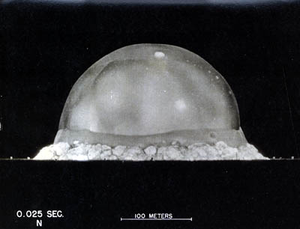
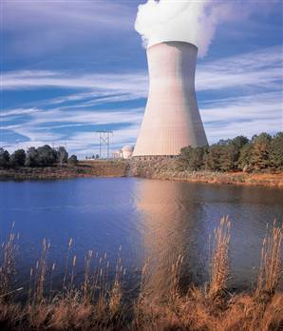
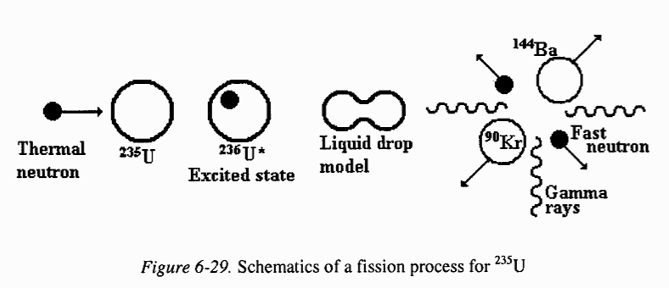
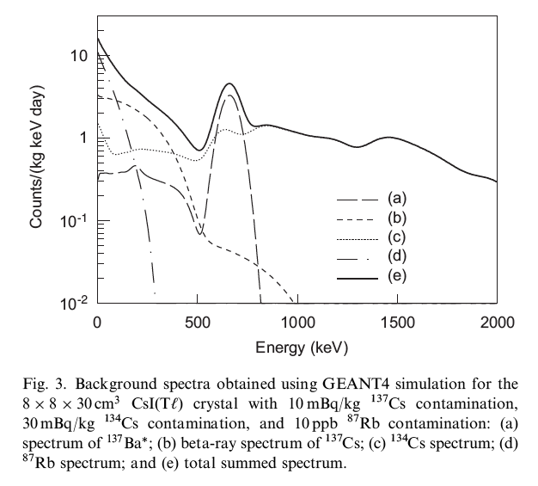
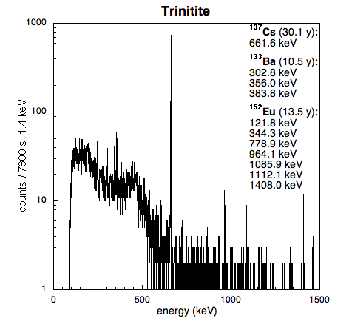
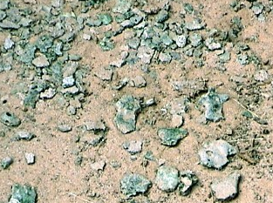
We live in a radioactive medium (and one day, “dark matter” will be regarded as just another form of radiation)
Many sources:
Primordial (U, Th, K)
Cosmogenic
Man-made
Man-made isotopes limiting
sensitivity of KIMS
Dark Matter detector
You can buy
anything
these days
on Ebay
Chemical
affinity:
a real pain
in the tuckus
Notes:
Rn Brodzinski (Rn or Po-210)
Lung cancer

Slide 7
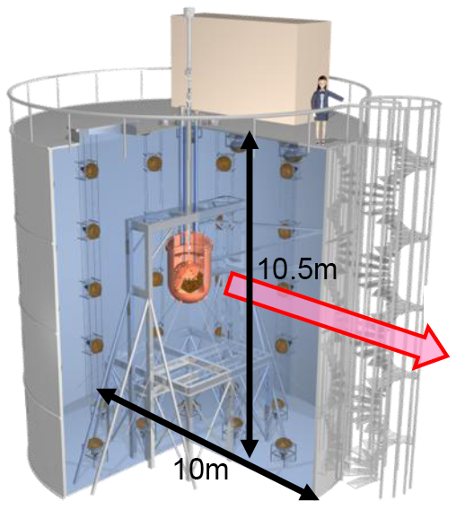
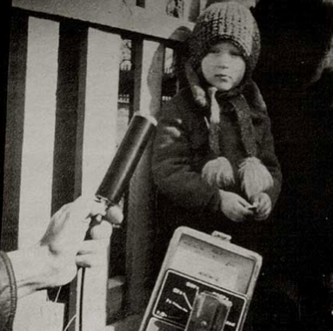
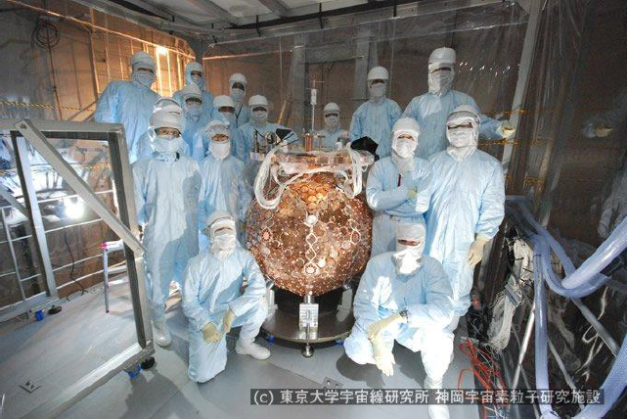
Remember that “W” in “WIMP”?
The challenge: to go from a
few hundred radiation events
per kg of detector mass per second…
…to a few
per ton per year
(and they have
to look like billiard
ball collisions)
Notes:
Rn Brodzinski (Rn or Po-210)
Lung cancer

Slide 8
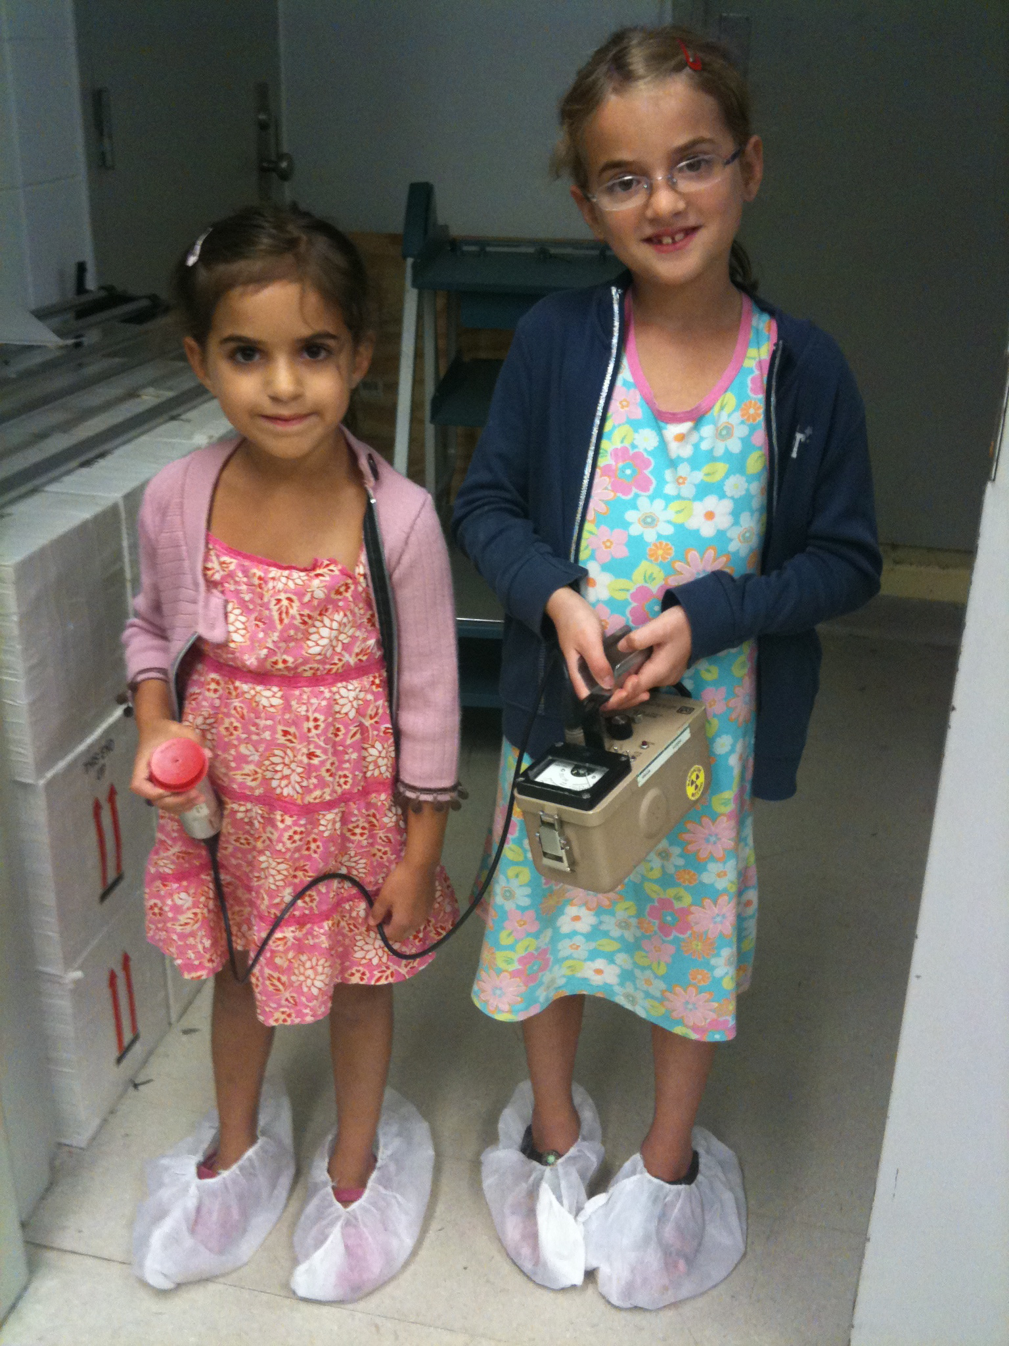
Remember that “W” in “WIMP”?
The challenge: to go from a
few hundred radiation events
per kg of detector mass per second…
…to a few
per ton per year
(and they have
to look like billiard
ball collisions)
Notes:
Rn Brodzinski (Rn or Po-210)
Lung cancer

Slide 9
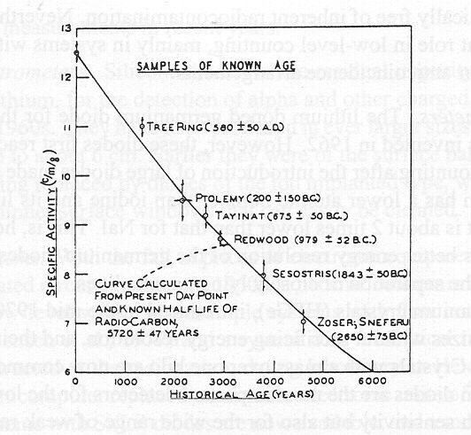
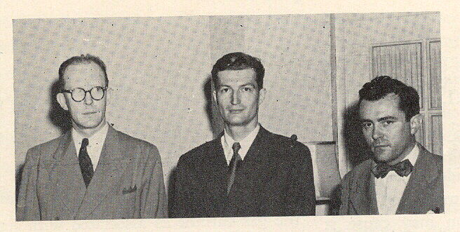
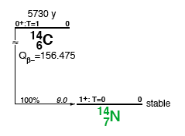
Enter low-background techniques
circa 1949
Problem for
Early ¹⁴C counters:
Background
rates ~100c/min
regardless of
shielding, largest
¹⁴C signal ~14c/g/m:
Birth of the
anticoincidence
veto
Pioneered at University of Chicago by W. Libby
(tradition continued by J. Simpson, T. Turkevich, etc.)
Cosmogenic origin: n_{th} + ¹⁴N → ¹⁴C + H
Fixed by plants via photosynthesis

Slide 10
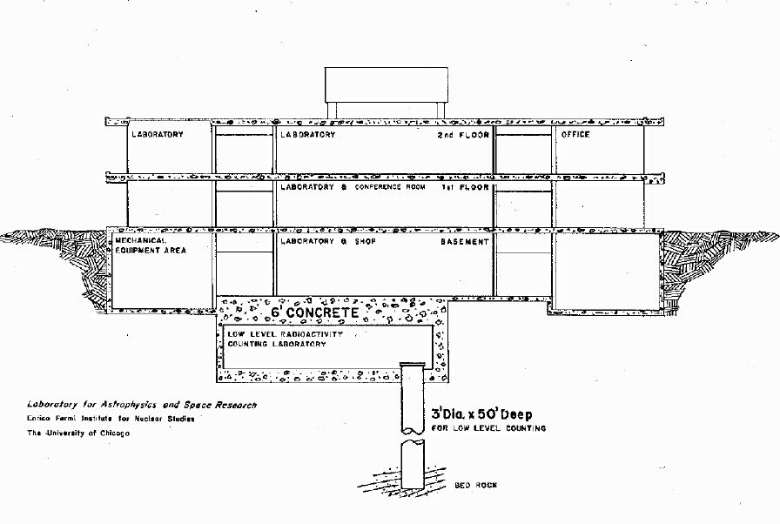
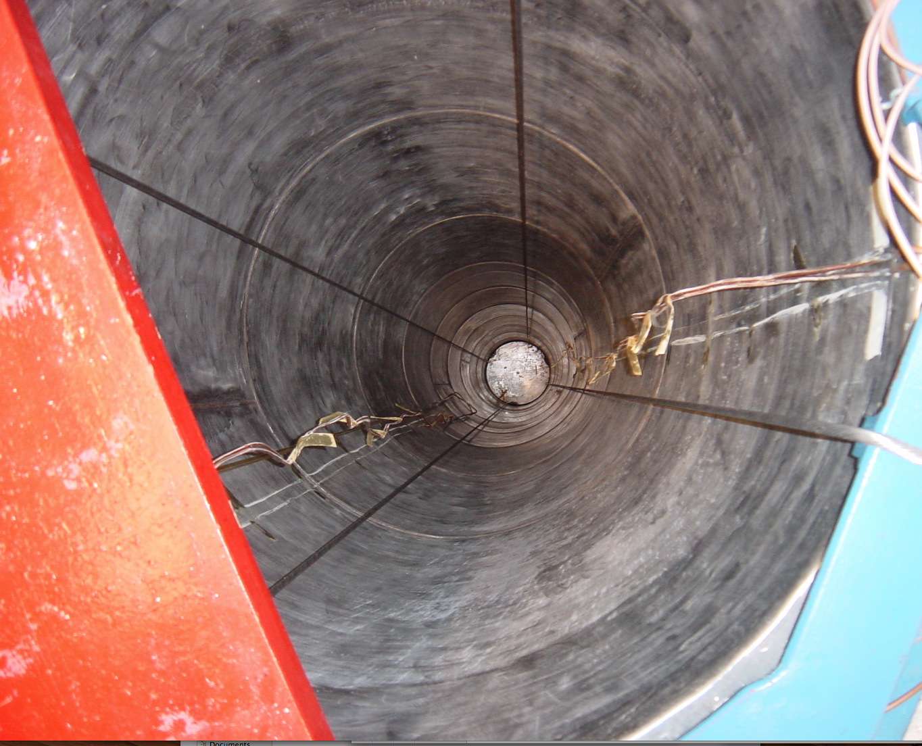
Enter low-background techniques
circa 1949
Problem for
Early ¹⁴C counters:
Background
rates ~100c/min
regardless of
shielding, largest
¹⁴C signal ~14c/g/m:
Birth of the
anticoincidence
veto
Pioneered at University of Chicago by W. Libby
(tradition continued by J. Simpson, T. Turkevich, etc.)
Cosmogenic origin: n_{th} + ¹⁴N → ¹⁴C + H
Fixed by plants via photosynthesis
Perfect storage
for moon rocks
and unruly
graduate students

Slide 11
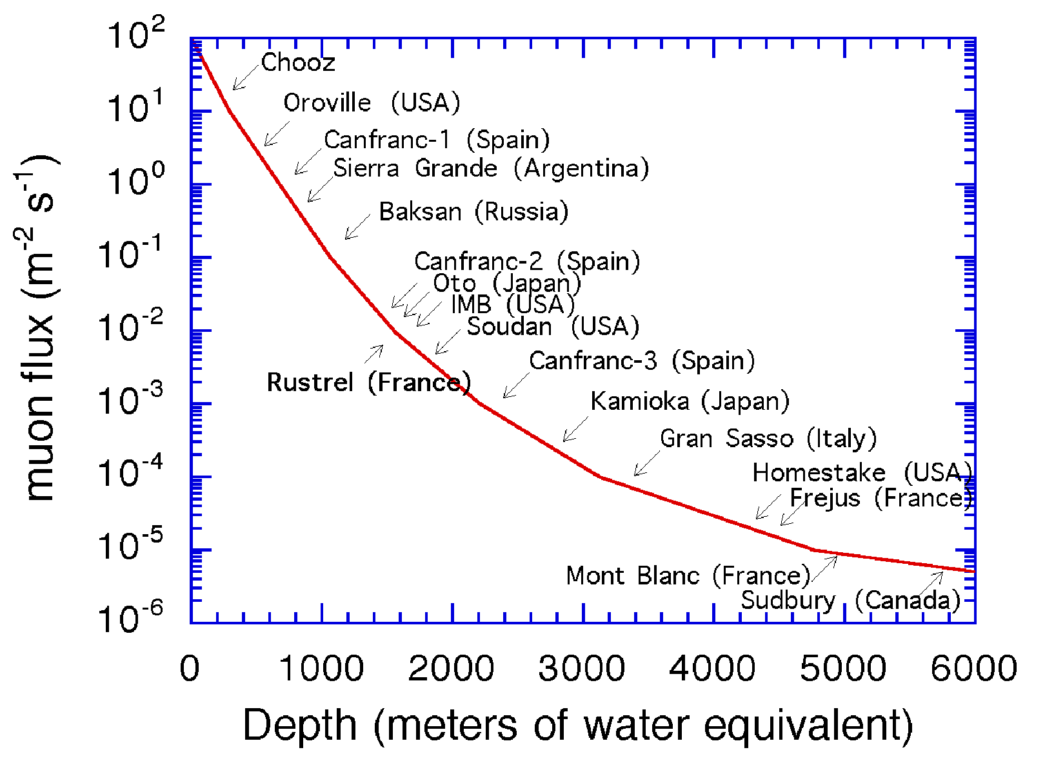
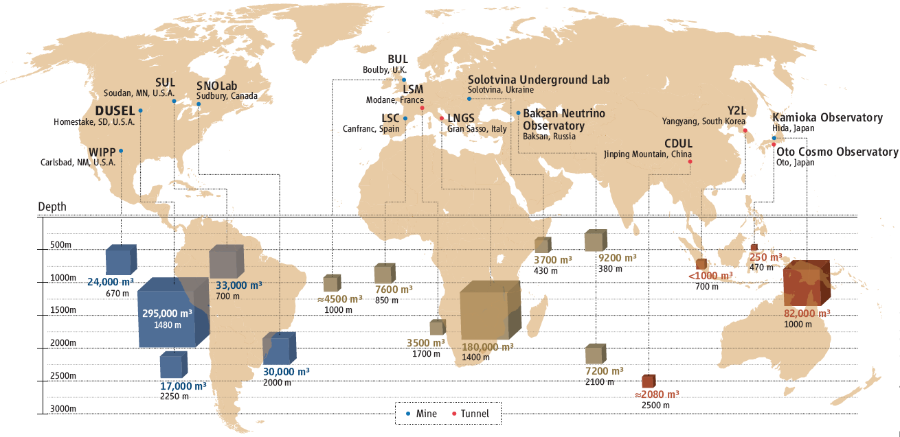
Low-background techniques (as applied to DM searches)
Bag-of-tricks:
Depth
Shielding (active & passive)
Radiopurity
Background rejection
Special detector properties

Slide 12
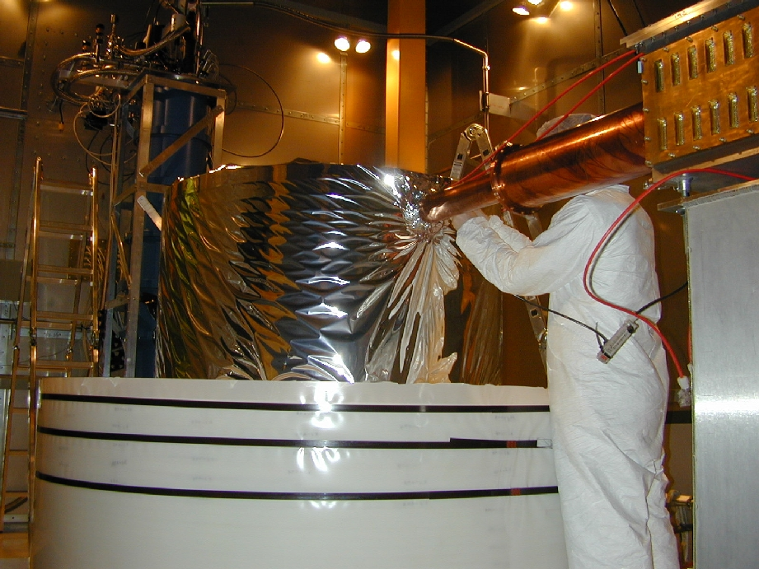
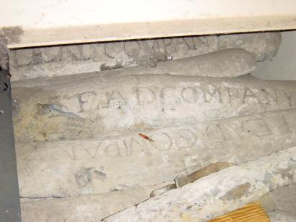
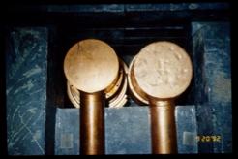
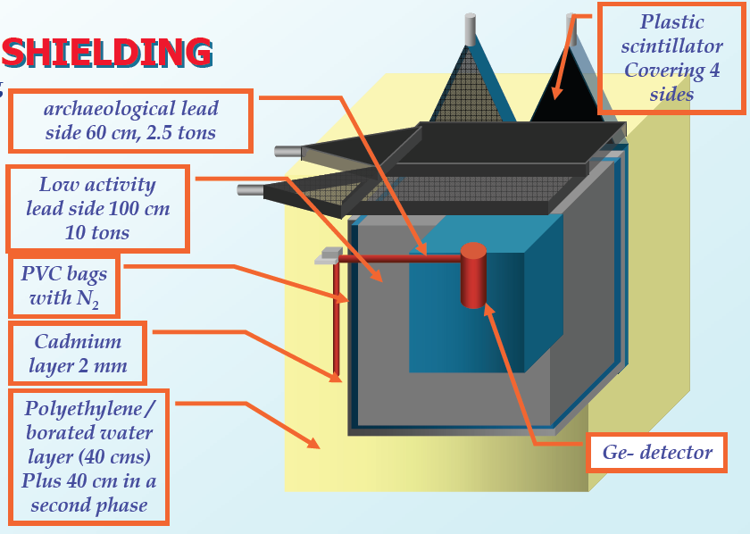
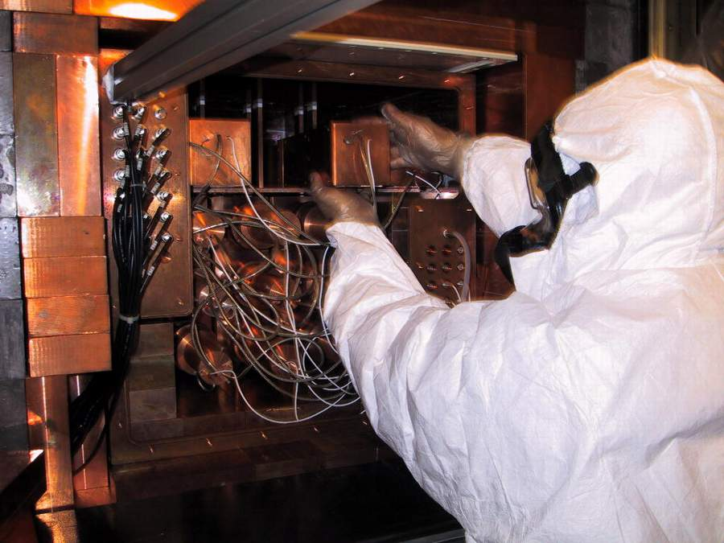
Low-background techniques (as applied to DM searches)
Bag-of-tricks:
Depth
Shielding (active & passive)
Radiopurity
Background rejection
Special detector properties
CDMS (US)
DAMA (EU)
DAMA (EU)
Notes:
Rn Brodzinski (Rn or Po-210)
Lung cancer

Slide 13
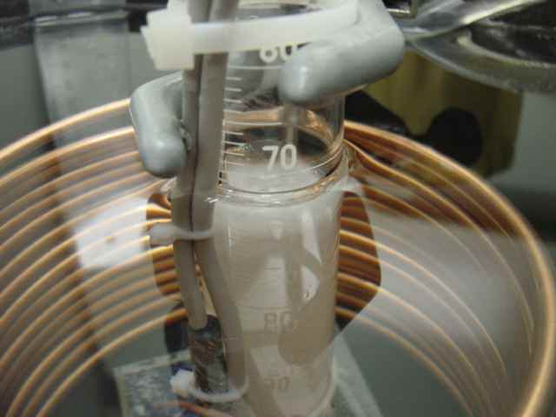
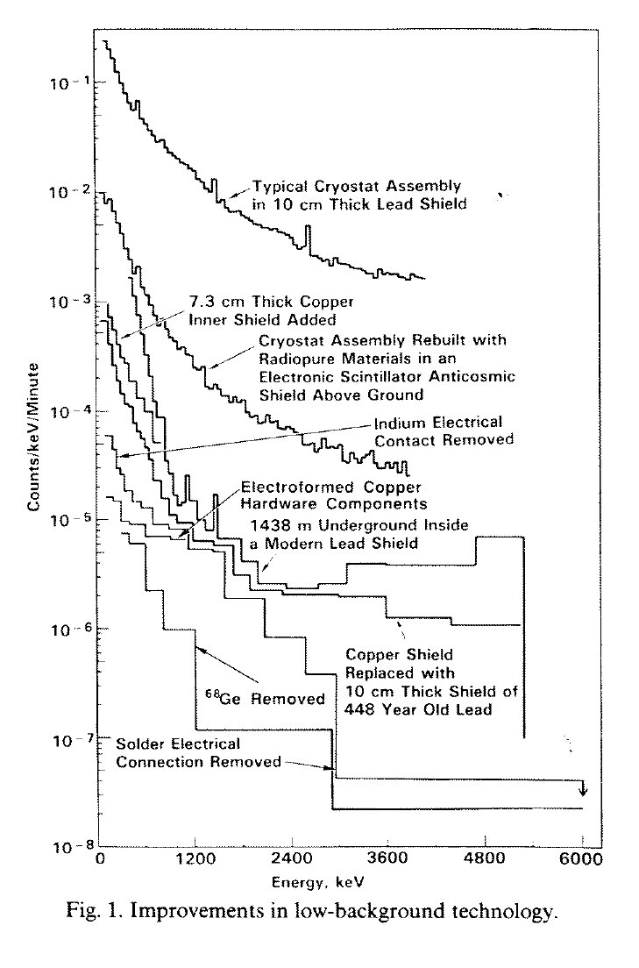
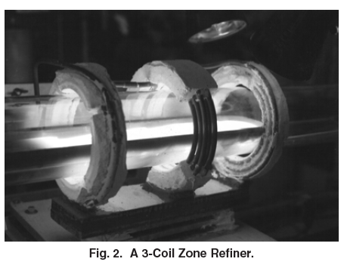
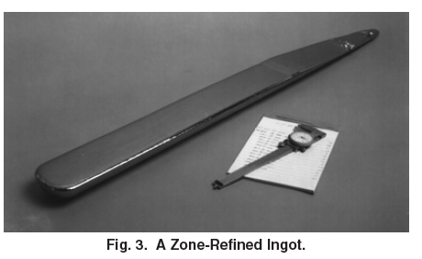
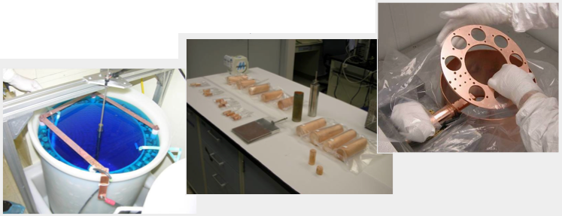
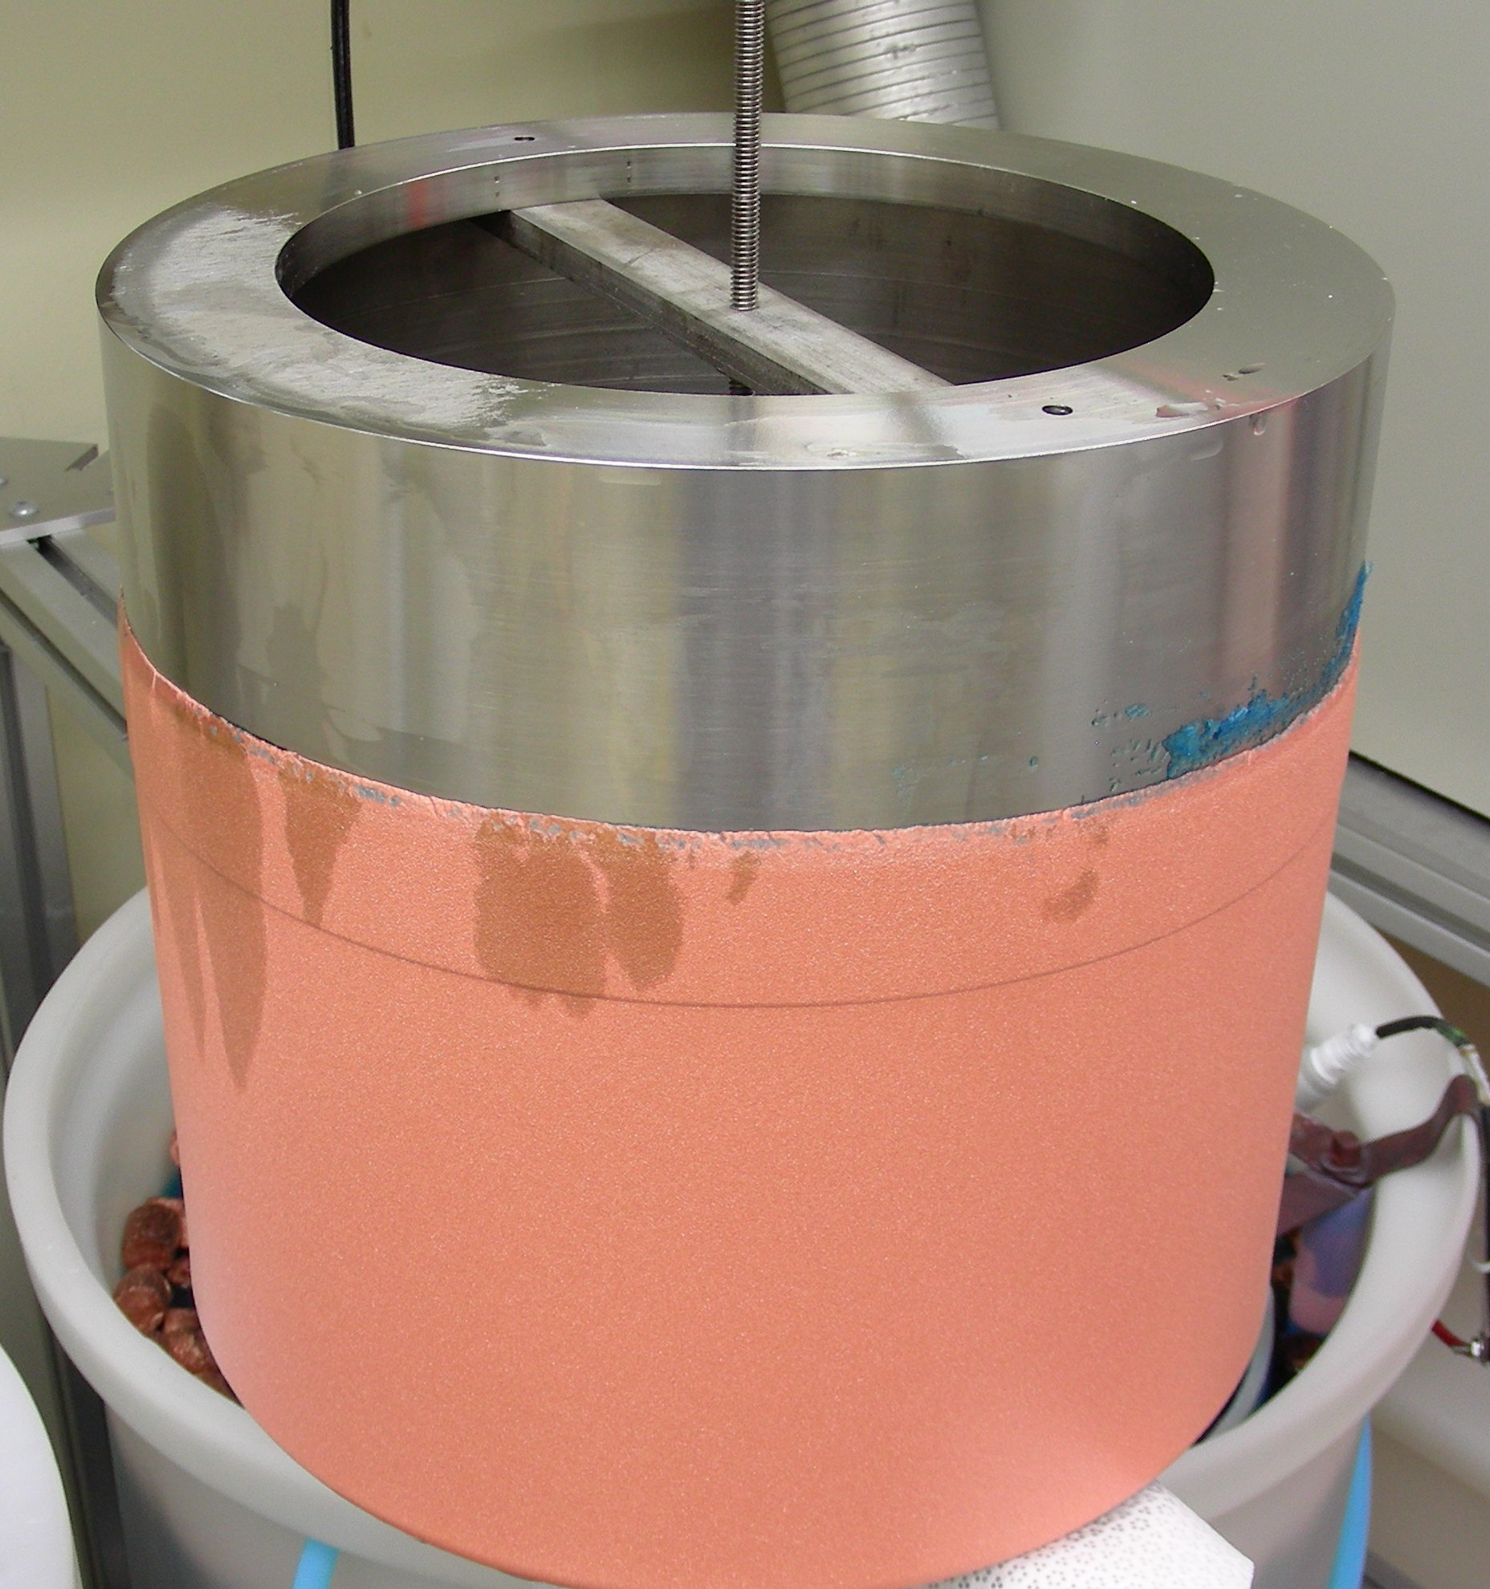
Low-background techniques (as applied to DM searches)
Bag-of-tricks:
Depth
Shielding (active & passive)
Radiopurity
Background rejection
Special detector properties
Directional freezing of C₆F₆
Ge zone refinement
impurities ~1E-13 g/g
Electroformed
Cu cryostat
…and yet not enough per se to catch a WIMP…
Notes:
Directional freezing

Slide 14
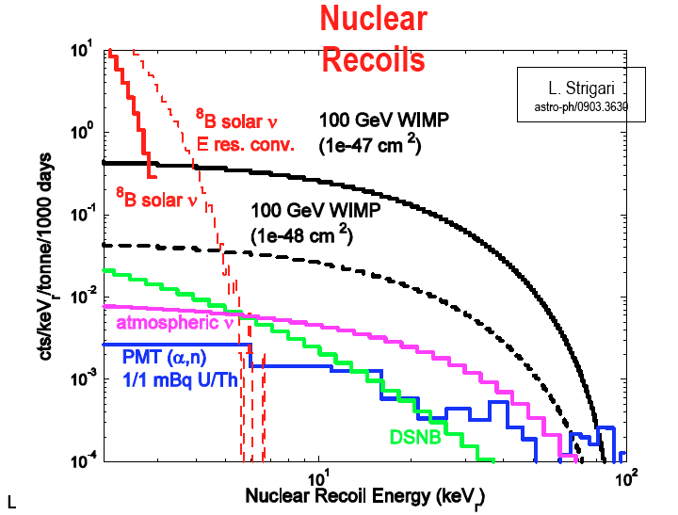
Low-background techniques (as applied to DM searches)
Bag-of-tricks:
Depth
Shielding (active & passive)
Radiopurity
Background rejection
Special detector properties
Ridiculous or sublime? (one way or another,
this is the end of the road)
Notes:
Rn Brodzinski (Rn or Po-210)
Lung cancer

Slide 15
Notes:
Rn Brodzinski (Rn or Po-210)
Lung cancer

Slide 16
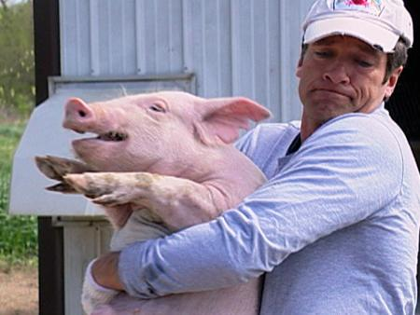
(theory types
come up with the
funny names,
we get to do the
rest of the job)
Notes:
Rn Brodzinski (Rn or Po-210)
Lung cancer

Slide 17
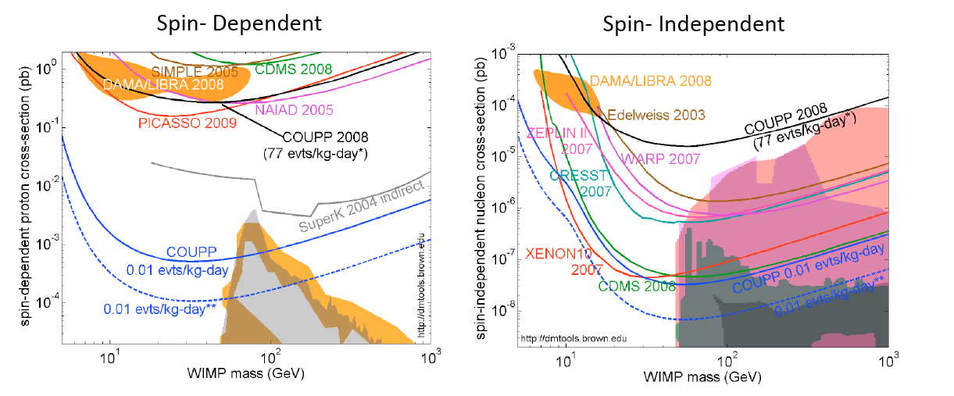
The sociology of this field:
Q: What do you get if everyone is right?
Notes:
Rn Brodzinski (Rn or Po-210)
Lung cancer

Slide 18
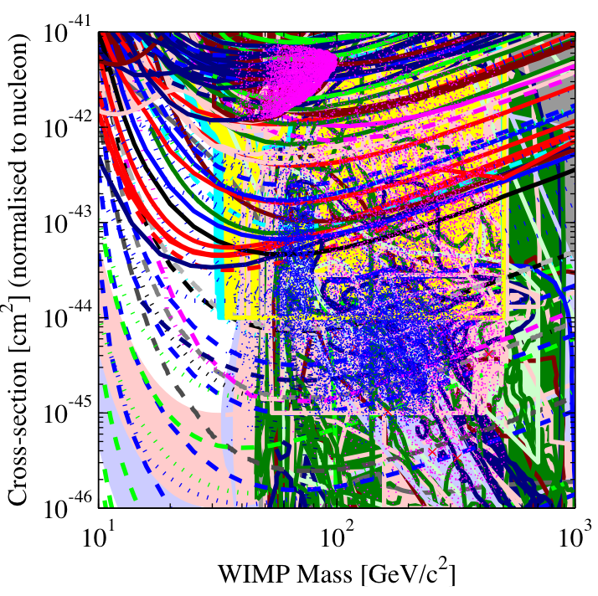
The sociology of this field:
A: ART
Notes:
Rn Brodzinski (Rn or Po-210)
Lung cancer

Slide 19
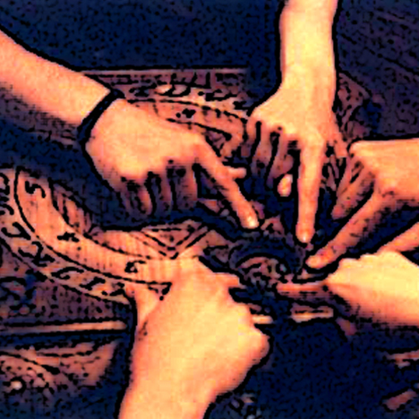
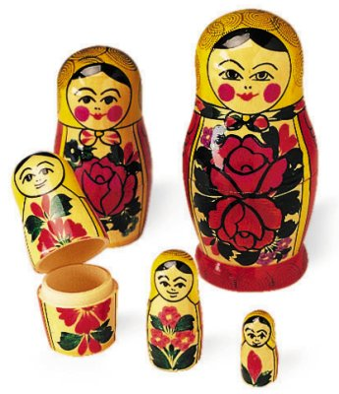
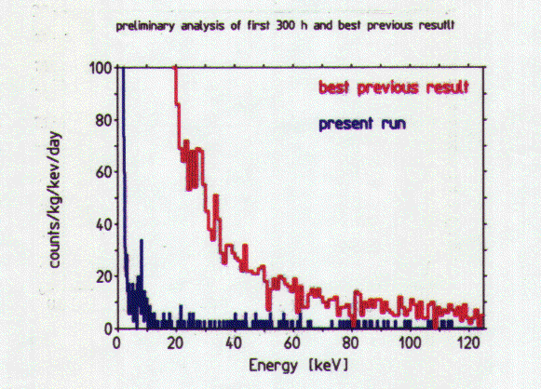
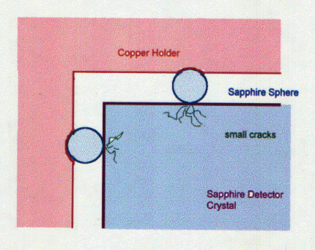
What will it take to call it “Dark matter”?
A number of “hints” of discovery already available.
But it takes just one finger on the Ouija board to
set it into motion…
The LHC should offer some help soon
(man-made Dark Matter!)
In a few years (decades?) we will regard Dark Matter as just another form of natural radiation (and a background to other experiments).
Along the way we will bump into many manifestations of natural radioactivity that we have not yet realized are there…
… and many mundane artifacts:
No degree of enthusiasm (impatience?) from us will hasten this process.
WIMp searches: a quixotic
fight against backgrounds.

Slide 20
Some of the fun toys we are going
to play with in the lab:

Slide 21
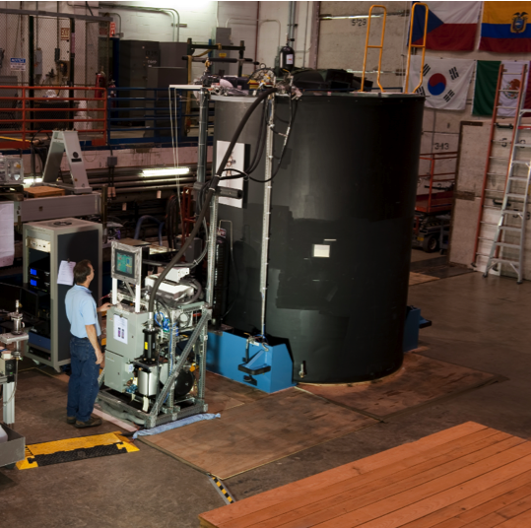
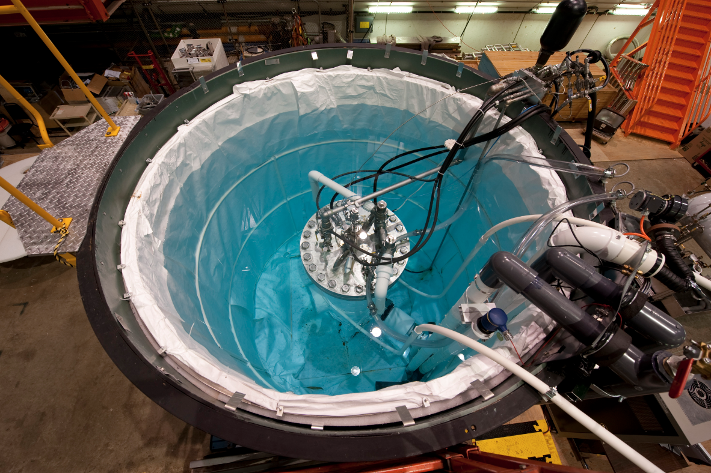
You have to start small before you grow BIG
Inch-sized early COUPP bubble chamber
COUPP 60kg at Fermilab (500kg in preparation)
Notes:
ra3h30dec-60, 225 deg2, our largest field from 2009.
alignment 657 331 40 95

Slide 22
You have to start small before you grow BIG
Pretty much the same, “Mythbusters” version
COUPP 60kg at Fermilab (500kg in preparation)
Notes:
ra3h30dec-60, 225 deg2, our largest field from 2009.
alignment 657 331 40 95

Slide 23
You have to start small before you grow BIG
Pretty much the same, “Mythbusters” version
COUPP 60kg at SNOLAB
Notes:
ra3h30dec-60, 225 deg2, our largest field from 2009.
alignment 657 331 40 95

Slide 24
Rejecting alphas: listening to particles (yes, listening)
PICASSO demonstrates α – nuc. recoil acoustic discrimination
in Superheated Droplet Detectors (SDDs)
F. Aubin et al., New J. Phys 10 (2008) 103017

Slide 25
E-961 progress: acoustic alpha - nuclear recoil discrimination
Neutron
Alpha
Phys. Rev. Lett. 106 (2011) 021303
We observe two distinct families of single bubble bulk events in a 4 kg chamber:
Discrimination increases with frequency, as expected.
We have a handle on which is which (Rn time-correlated pairs following injection, S-AmBe calibrations, NUMI-beam events).
Very high discrimination against α’s is clear (~1E-5 rejection factor, we don’t have enough statistics yet to determine this)
Discrimination is considerably better than in PICASSO’s droplet detectors (multiple reasons for this).
Challenge in obtaining same discrimination in the larger devices: increasing number of sensors while reducing (α,n).
Relaxes internal radiopurity goals by 4-5 orders of magnitude

Slide 26
COUPP progress: acoustic alpha - nuclear recoil discrimination
SNOlab COUPP-4kg data
Gamma rejection >1E+10
(best in the field)
acoustic α rejection >>99.9%
(don’t know where it will stop yet)

Slide 27
The devil is in the details
(quenching factors, channeling)
Ongoing precision measurements of CsI[Na] and NaI[Tl] quenching factor and CHANNELING at UC to cast light on effects of methodology, kinematic cutoff, etc.
Bozorgnia, Gelmini & Gondolo
Small 6 cc crystal
(= single scatters)
Certain models
predict non-negligible channeling: it must be measured!!!
* Response to both
electron and nuclear
recoils measured.
*Use of ultra bialkali
PMT (40% QE) to
avoid threshold
effects (x3 light yield
of previous meas.)
*Crystal with known
(growth) axis
orientation.
Double goniometer
2.8 MeV DD neutron gun
(neutron scattering)
Compton
scattering

Slide 28
Age of anomalies: are DAMA, CoGeNT and CRESST in agreement, or not at all?
…and these are detector aspects only
(throw in a dash of particle physics and astrophysical uncertainties for a total chaos)

Slide 29
More on particle identification:

Slide 30
More on particle identification:

Slide 31
More on particle identification:

Slide 32
EL TPCito (a wonderful educational dark matter toy by J.T. White, Texas A&M)
PMT
TPB-coated window
1.5 cm
Anode grid
HD polyethylene vessel
4.6 cm
Gate grid
Field rings
Cathode
HV Feed-thrus

Slide 33
EL TPCito (cont)
source location

Slide 34
Electro-statics
Electric Field Lines
Electric Potential
EL gap
Drift region

Slide 35
PPCs: reducing capacitance and noise, exploiting charge collection features for background reduction (surface & multiple-site).
Conventional
HPGe coaxial
detector
PPC HPGe
~400 eV threshold,
working on
further reduction
Why bother: few keV signals expected from WIMPs, esp. at low mass.
Quenching factor does not help.
Present PPCs dominated by parallel-f noise:
Noise identification detective work (approximately ~2 years of cracking detectors open):
PTFE
losses
Noise abatement not dissimilar to background reduction:
one layer of crap hides the next one (noise terms add in quadrature!).
(all of this noise mumbo-jumbo actually checks)

