Slide 1
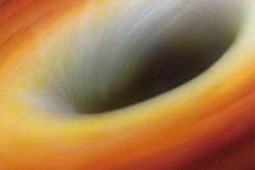
Einstein’s Outrageous Universe: Gravitational Waves, Black Holes, Gravitational Lenses & the Big Bang
KICP Short Course Overview
Michael S. Turner
Kavli Institute for Cosmological Physics
University of Chicago

Slide 2
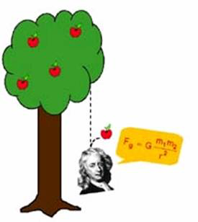
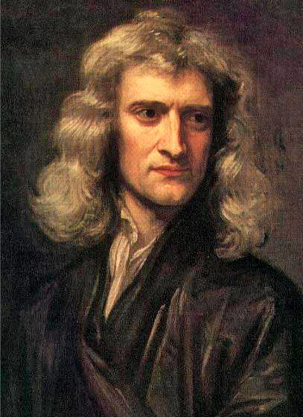
229 years: Newton had a good run
It’s all about forces!
3 Laws of motion
+ Universal law of gravitation →
Explains gravity and motion everywhere
Newton’s Principia, 1687

Slide 3
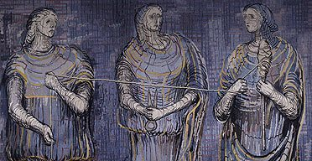
Circa 1900: some small problems with Newtonian gravity
Precession of the perihelion of Mercury
  43” (of 5600”) per century unexplained
Effect of gravity is instantaneous
Inconsistent with Special Theory of Relativity
Loose threads that unraveled a beautiful tapestry

Slide 4

1915: Einstein’s General Relativity
Tweetable version
Space is flexible, time warps
Matter tells space how to bend
Space tells matter how to move
Not a small tweak, a complete re-think!

Slide 5
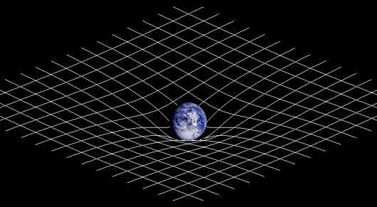
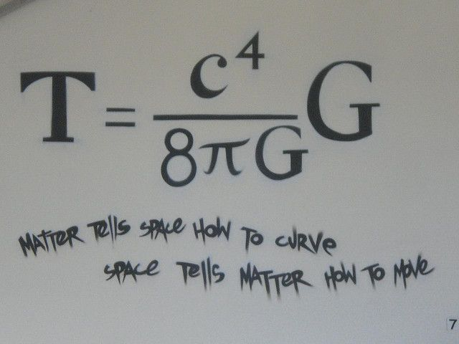
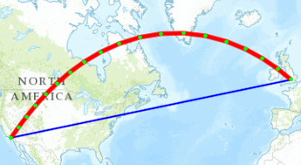

Slide 6
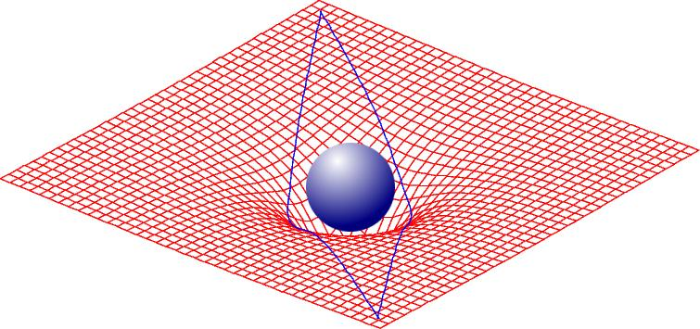
New features of General Relativity
Bending of star light near a massive object

Slide 7
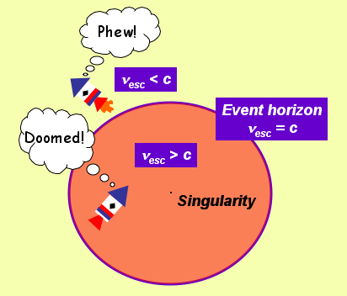
Event horizon: point of no return (black hole)
New features of General Relativity
←For the sun 6 km→

Slide 8
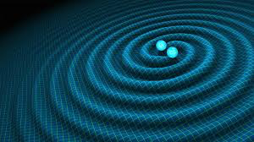
New features of General Relativity
Ripples in space time that move at the speed of light (gravitational waves)

Slide 9
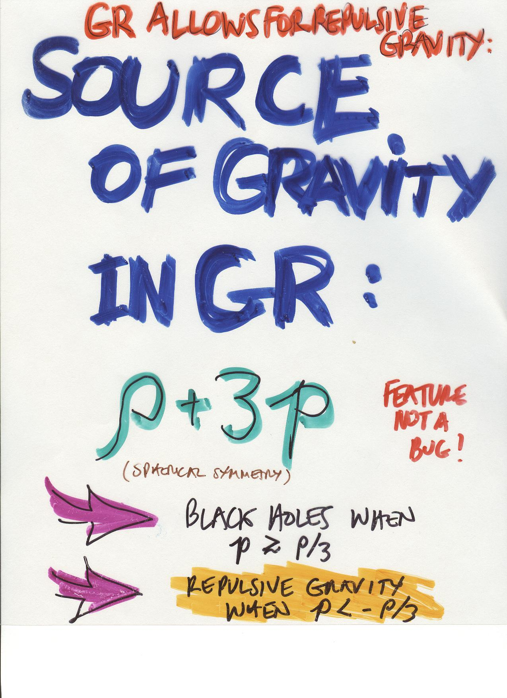
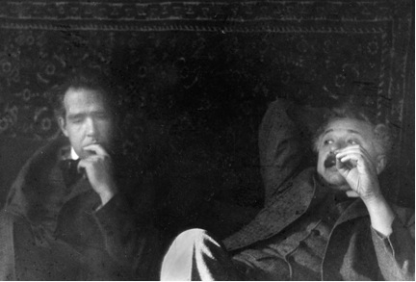
New features of General Relativity
Repulsive gravity!#

Slide 10
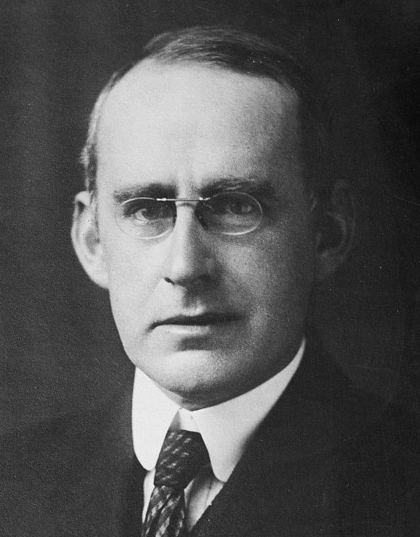
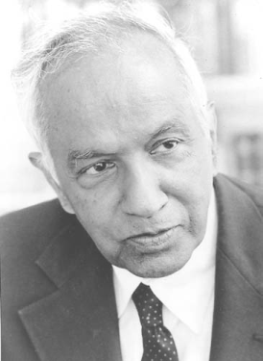
Almost 100 years to fully understand and test General Relativity
“Asked in 1919 whether it was true that only three people in the world understood the theory of general relativity, [Eddington] allegedly replied: 'Who's the third?”
― Arthur Stanley Eddington
“Asked by Bruce Winstein about Einstein’s understanding of general relativity, he replied, “it was very limited!”
― Subrahmanyan Chandrasekhar

Slide 11
Bold new predictions
Black holes: everything goes in, nothing comes out!
  Reality not sorted out until 1960s
Gravitational waves: ripples in space time
  Reality not sorted out until late 1950s
Gravitational lensing: multiple images
  Einstein concluded it was too small to observe
Big bang: expanding space explodes from a big bang beginning to galaxies moving apart
  Einstein and others confused until 1930s
Dark energy: mysterious stuff with repulsive gravity
  We are all still confused!
“boutique science” until 1963 – only
for experts and mathematicians

Slide 12
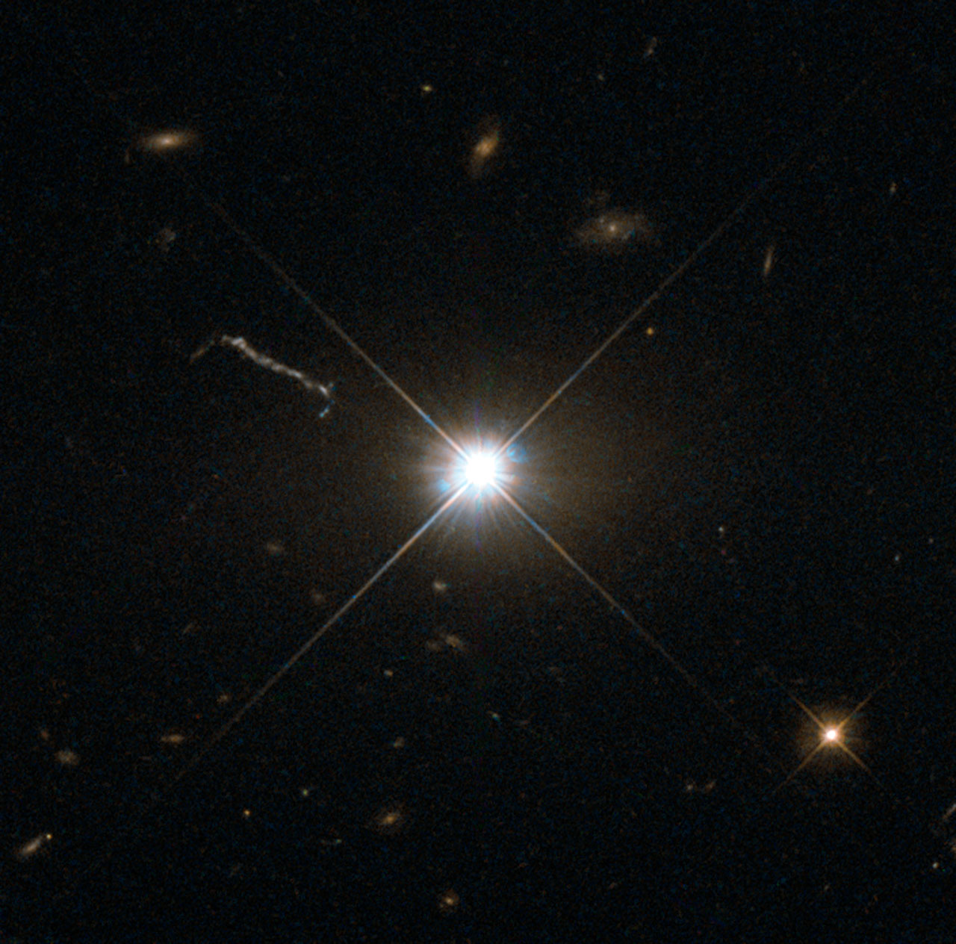
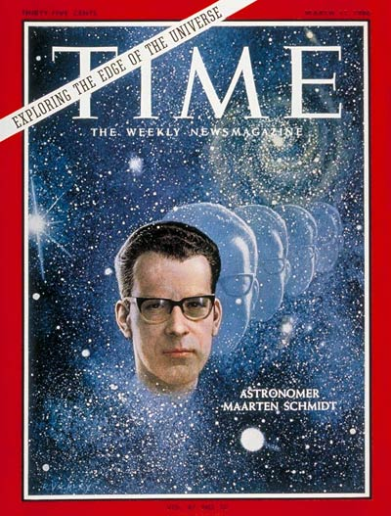
Everything changed in 1963: Quasars
Distant
Compact
Highly luminous
Exotic and newsworthy
Supermassive black holes at the centers of distant galaxies!

Slide 13
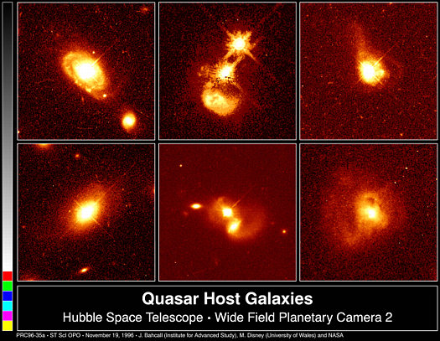
Quasars: galaxies in their terrible twos

Slide 14
The floodgates opened
1963: Quasars
1964: Discovery of the Cosmic Microwave Background (echo of “big bang”)
1967: Pulsars (neutron stars)
1971: Cyg X-1 (first black hole)
1974: Hulse-Taylor binary pulsar
1974: Sgr A* (black hole at Milky Way center)
1976/77: Discovery of gravitational arcs

Slide 15
The floodgates open
1979: Gravitational lensing (twin quasar 0957+561)
1982: Evidence for GWs (orbital decay of binary pulsar)
1998: Accelerating Universe and dark energy
2000: Supermassive BH at the center of every galaxy
2015/6: Discovery of gravitational waves

Slide 16
No going back!
We live in
Einstein’s outrageous Universe

Slide 17
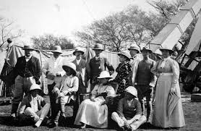
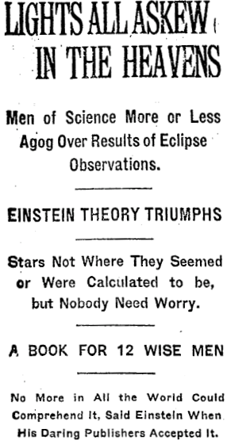
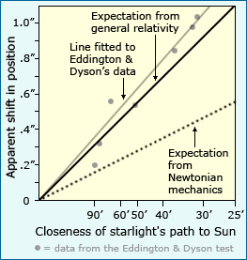
Bending of starlight: First big test

Slide 18
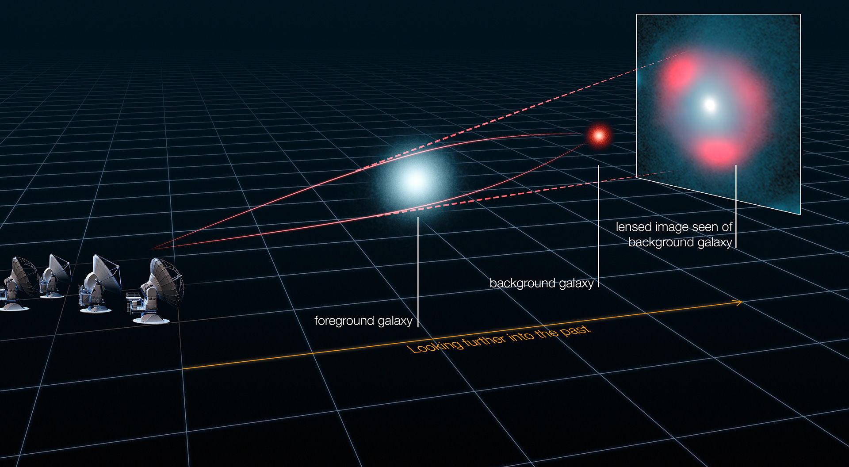
Gravitational lensing

Slide 19
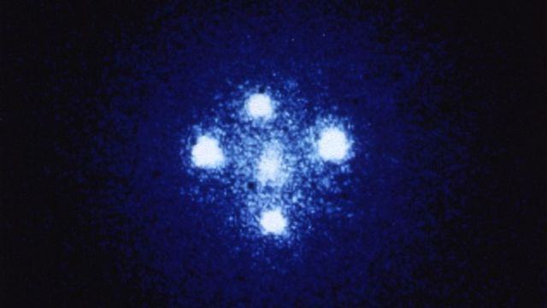
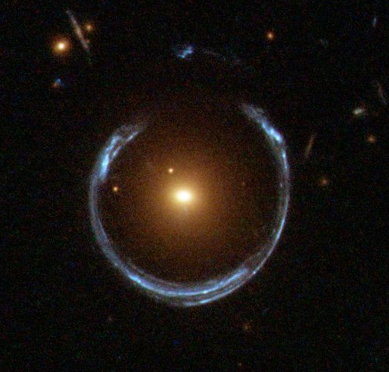
Gravitational Lenses:
Einstein Cross and Einstein Ring

Slide 20
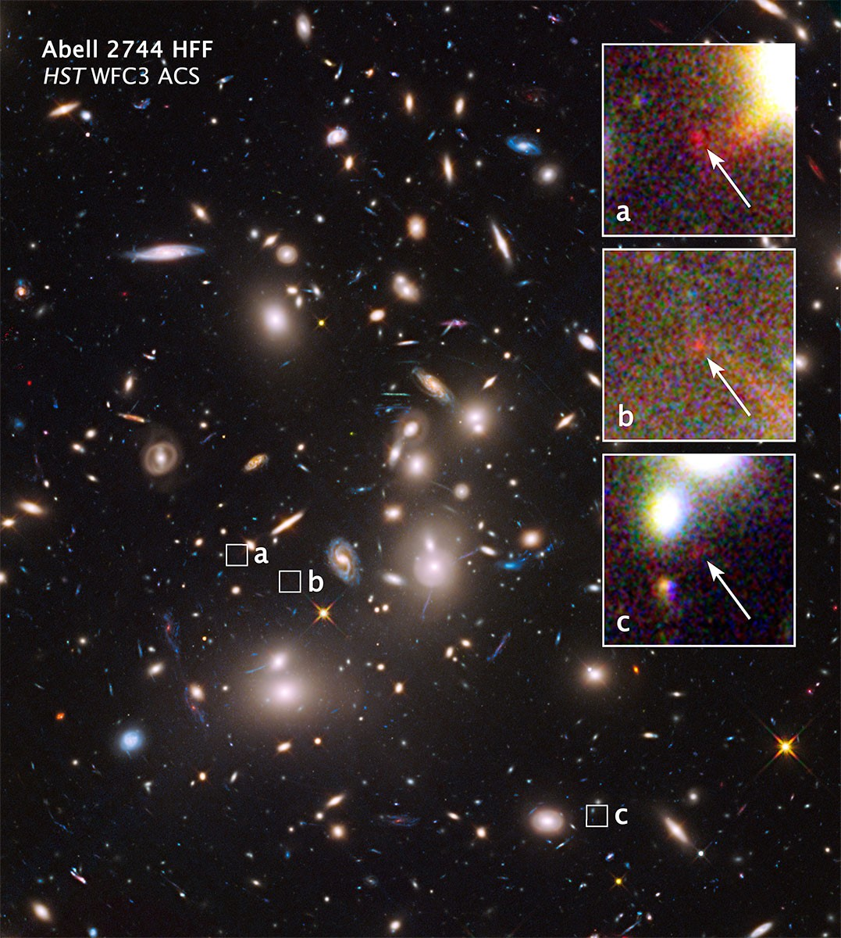
Gravitational “magnifying glass”

Slide 21
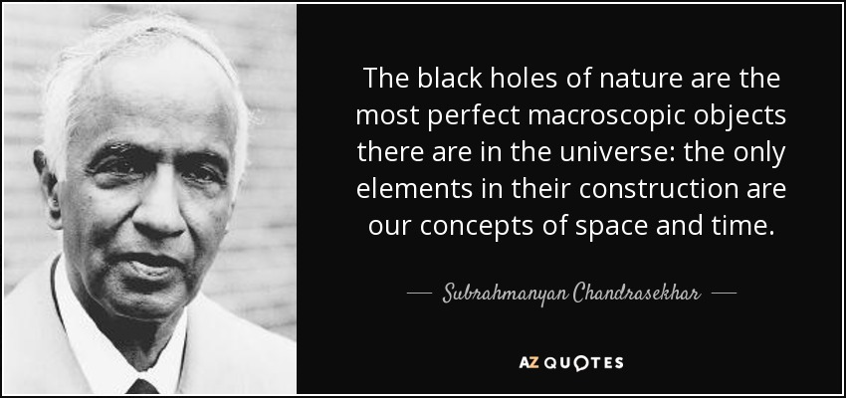
The BH solution of GR

Slide 22
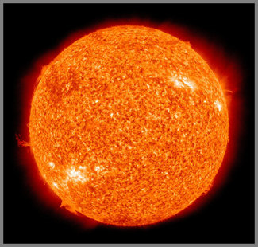
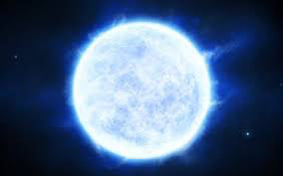
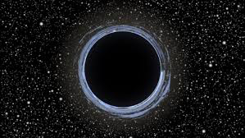
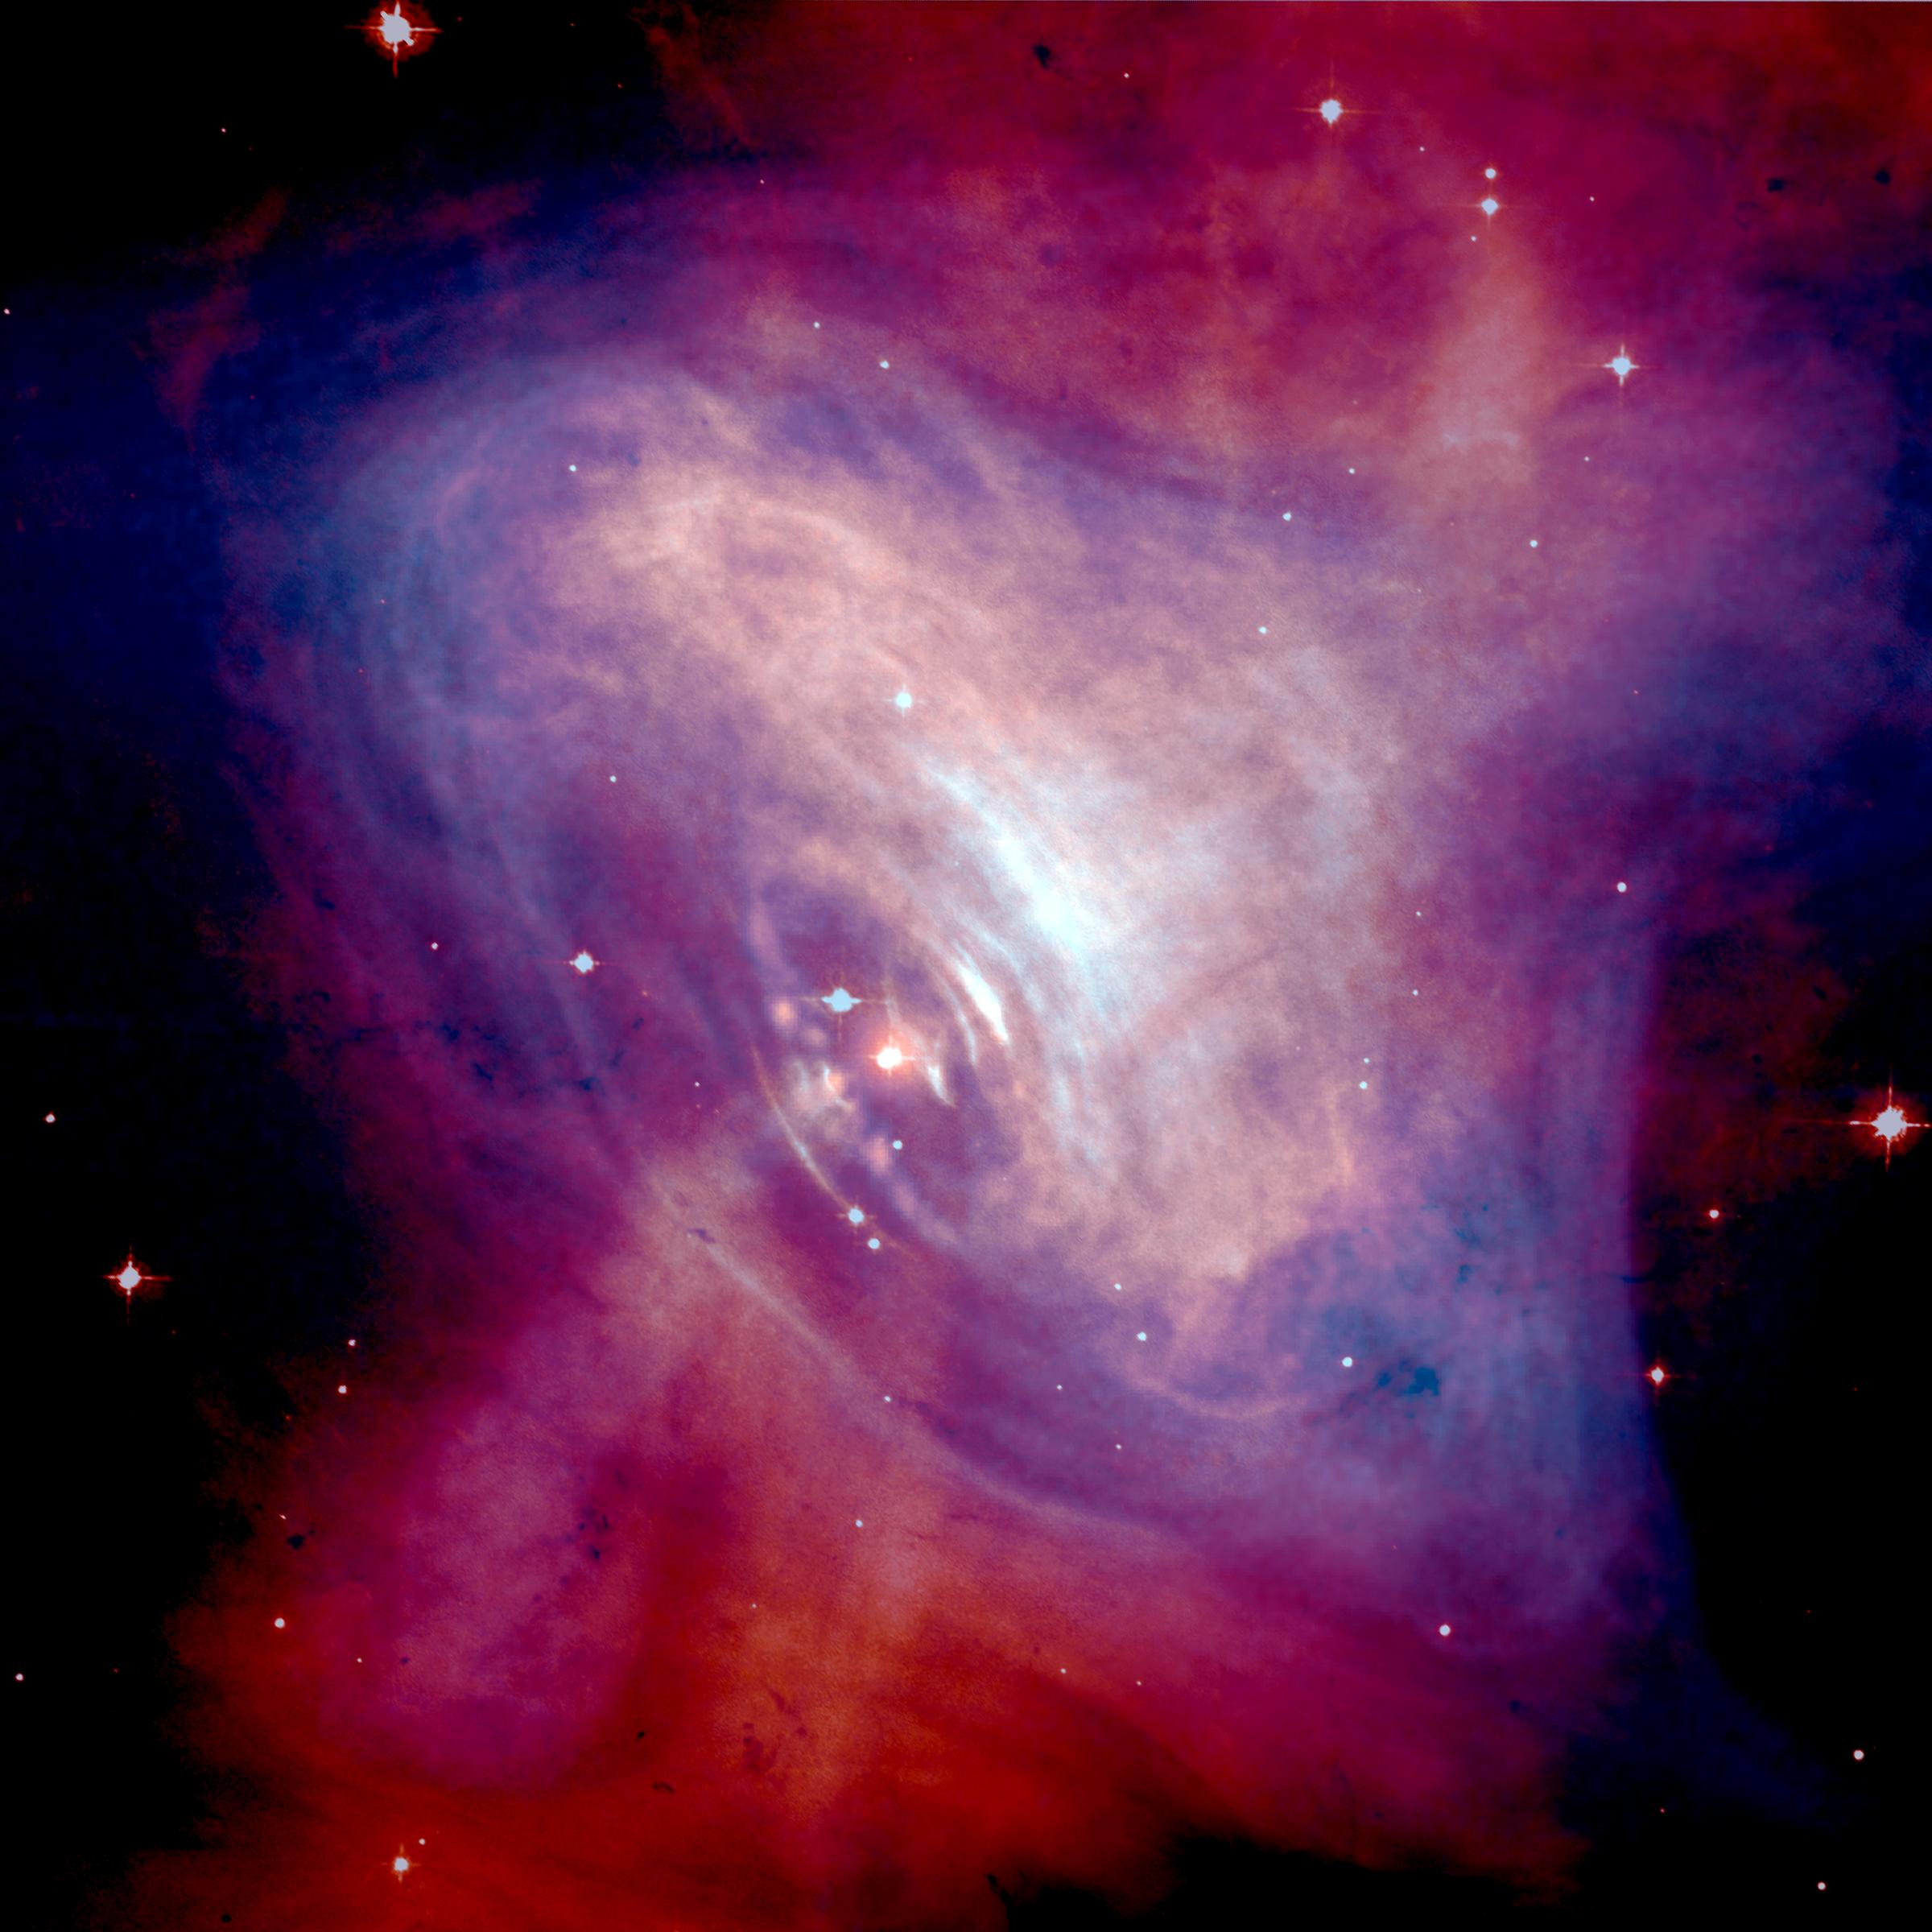
What is special about a black hole?
It is so small that you can get very close to it -- within event
White dwarf: 7,000 km
Sun: 700,000 km
Neutron star: 15 km
Event horizon for a solar mass star: 6 km

Slide 23
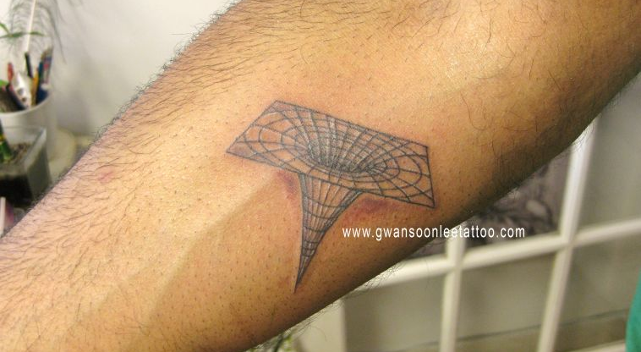
Black hole horizon tattoo

Slide 24
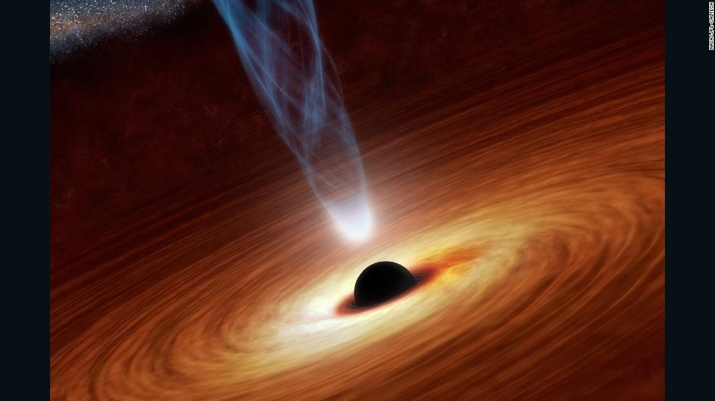
… not black because material falling in produces radiation as it plunges

Slide 25
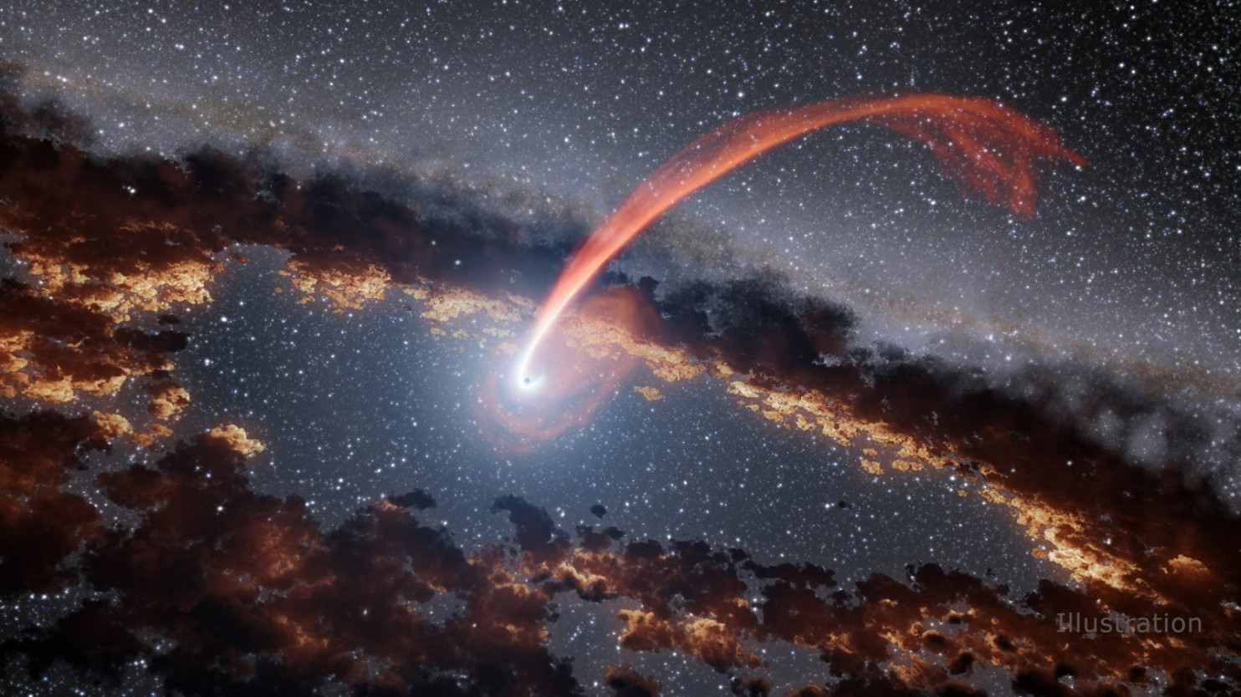
Scientists caught black holes swallowing stars — and burping energy back up

Slide 26
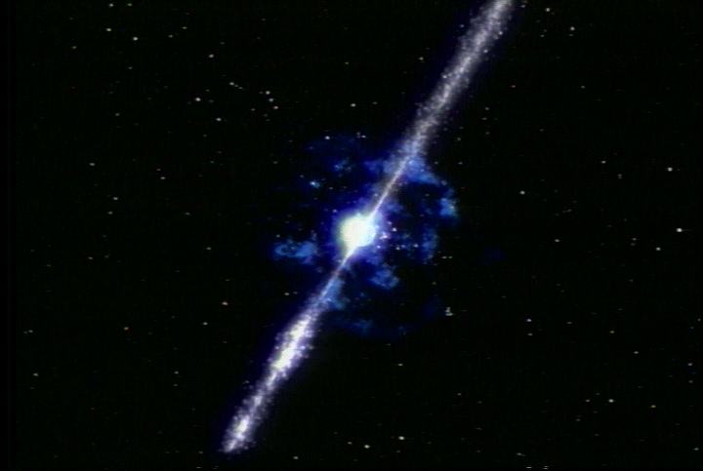
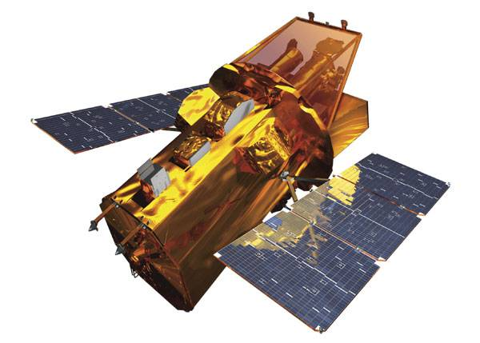
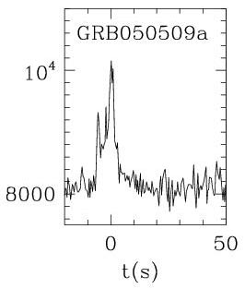
Gamma-ray bursts: at least 10 black holes born every second!
SWIFT

Slide 27
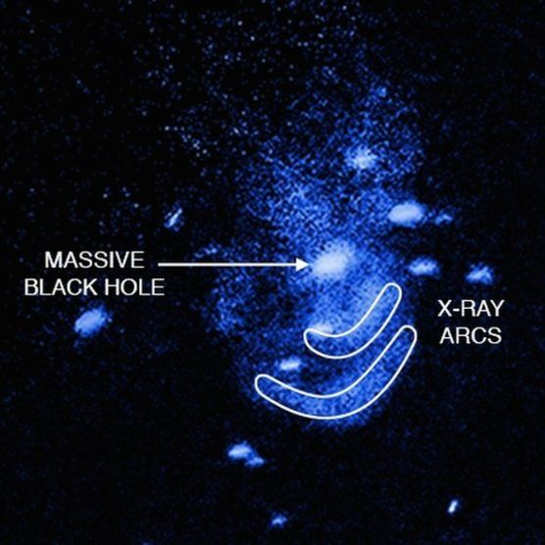
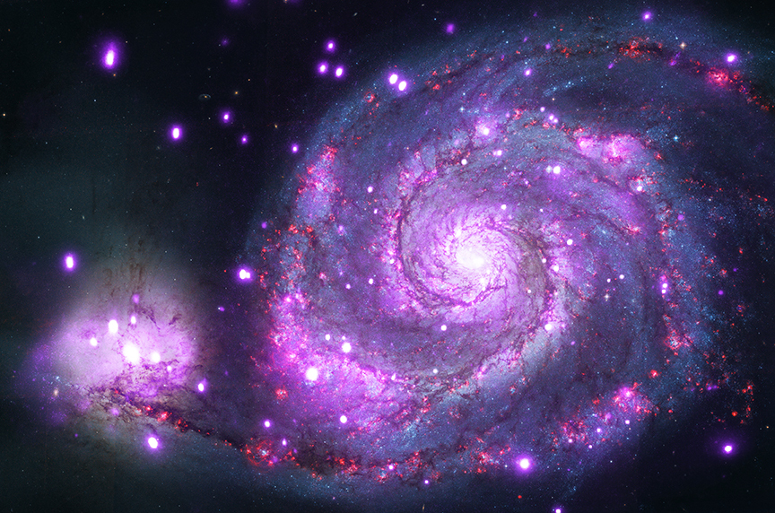
Supermassive black hole at center of Whirlpool galaxy emits x-rays

Slide 28
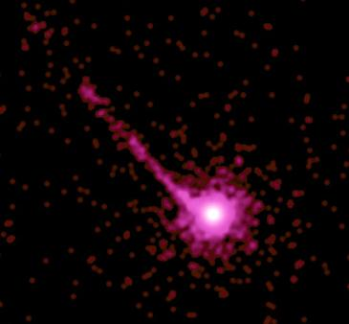
Million light-year jet from supermassive black hole

Slide 29
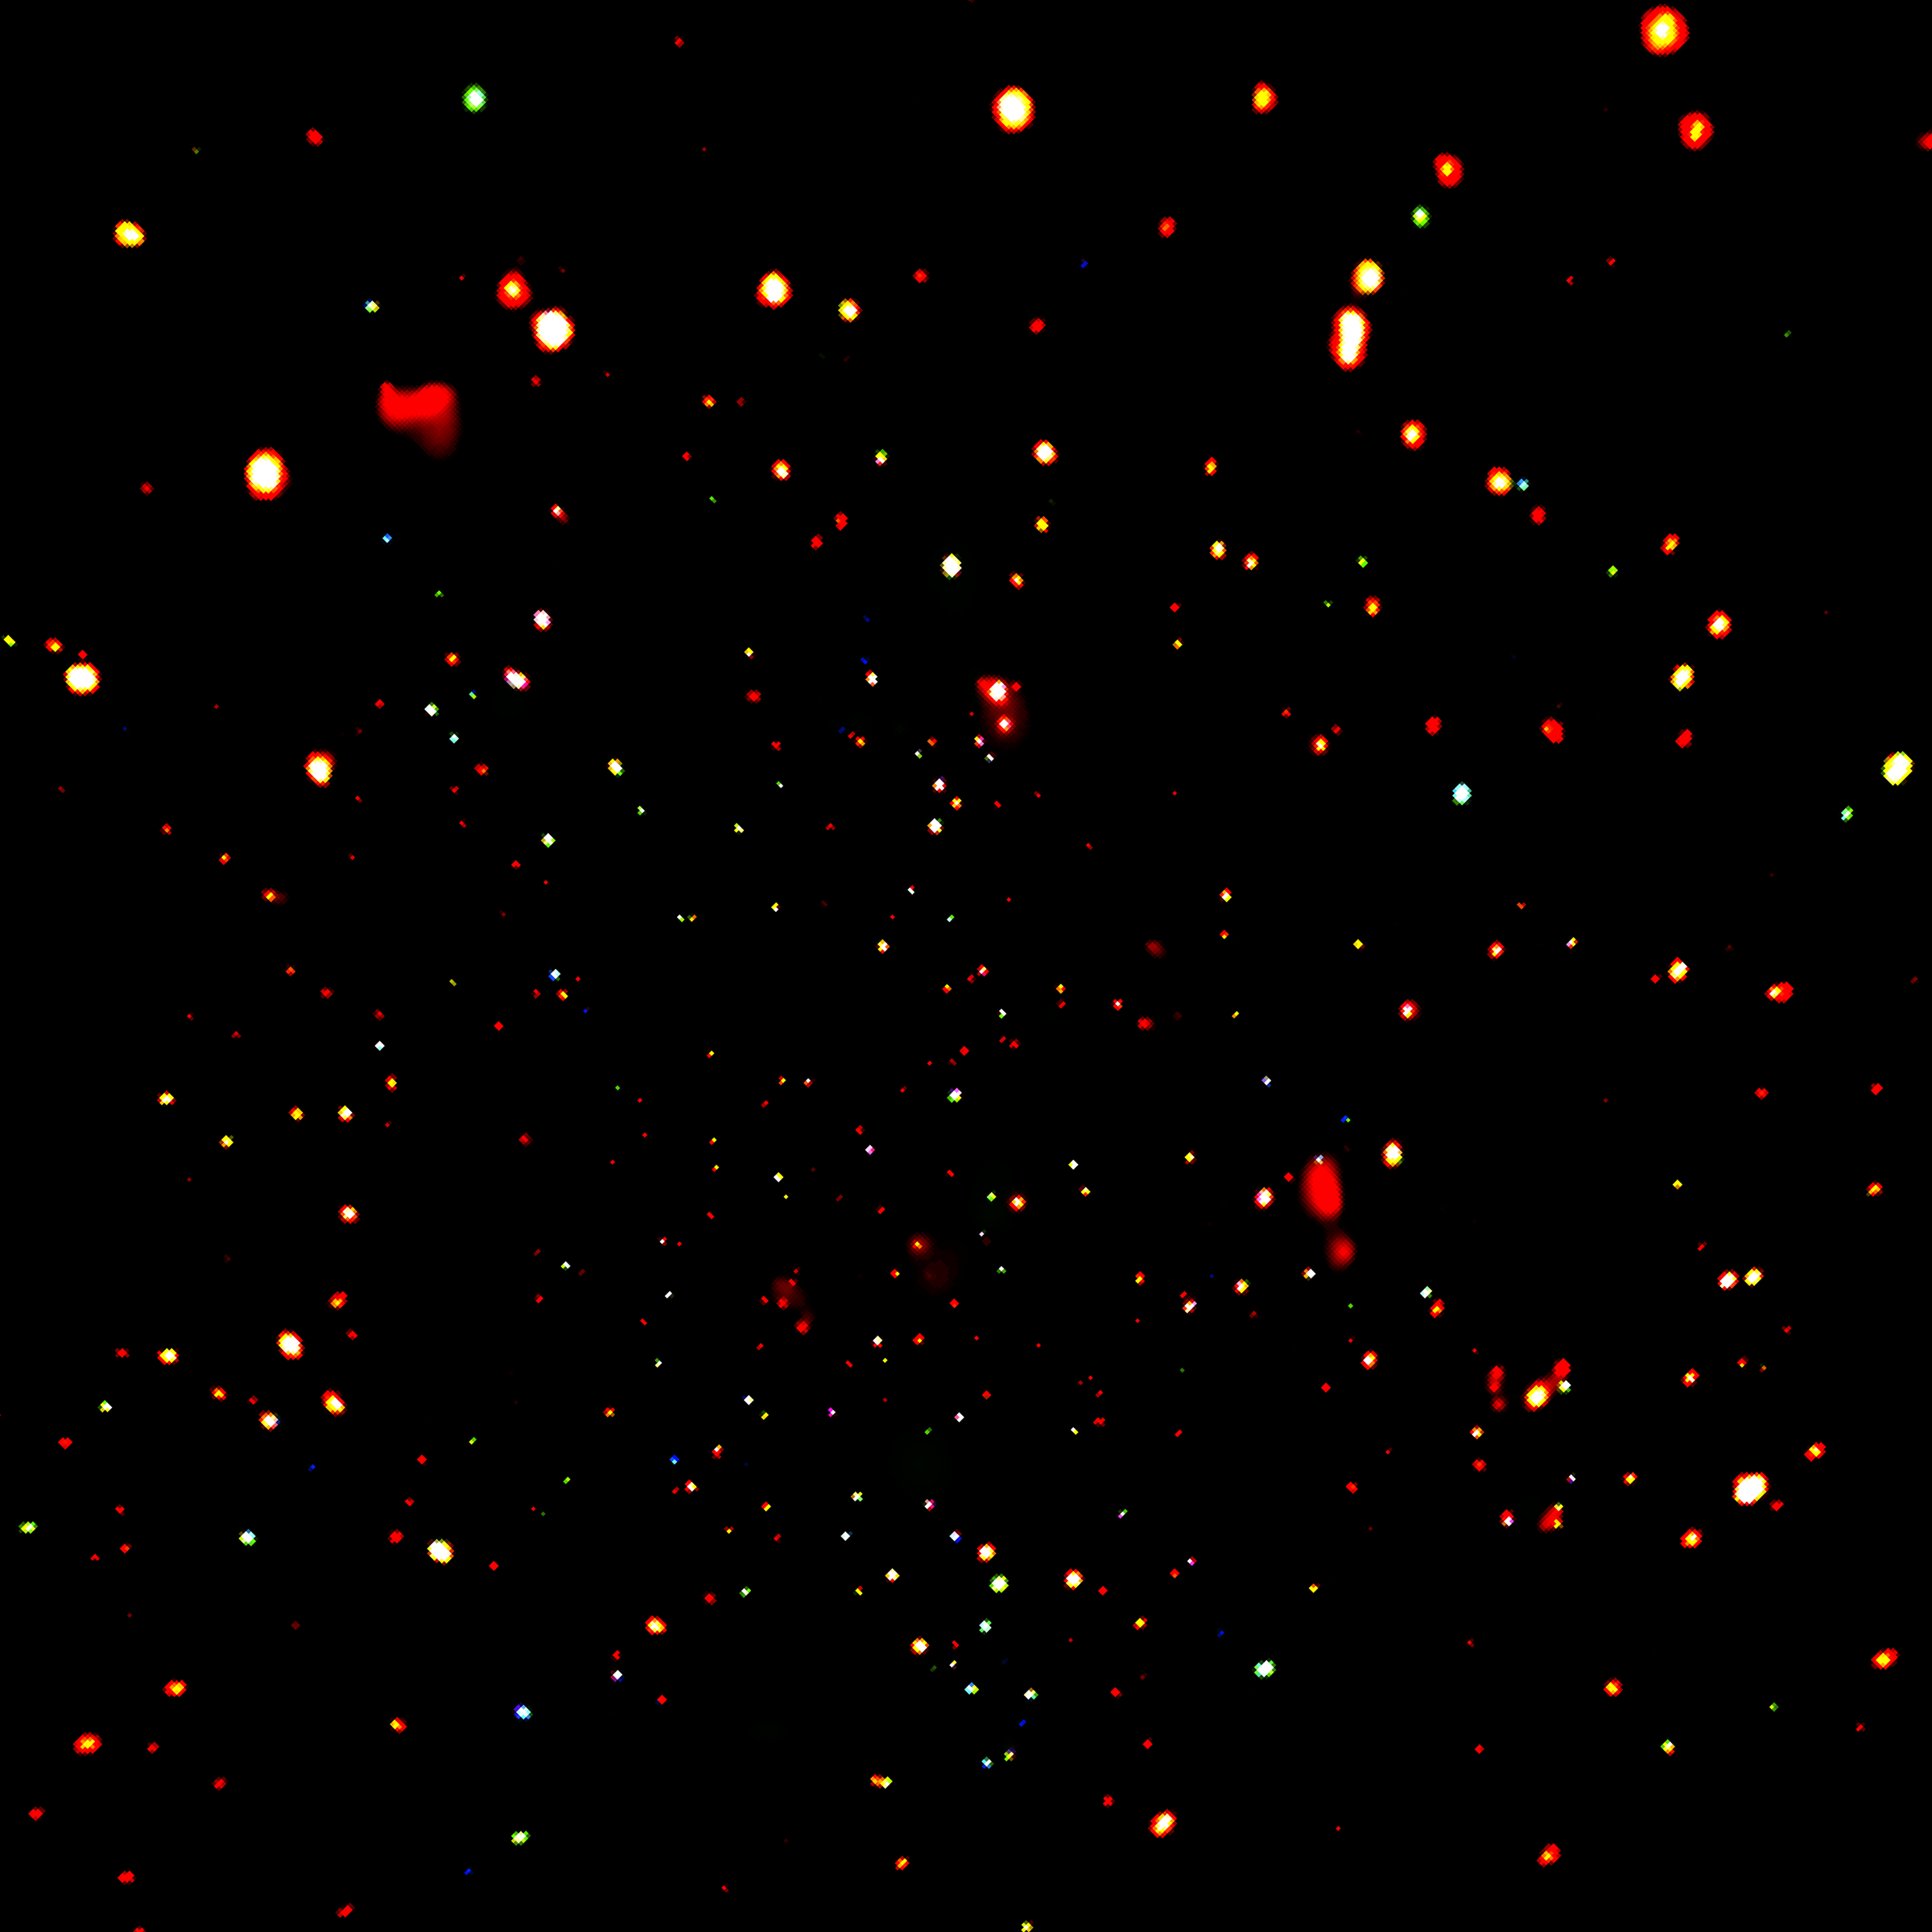
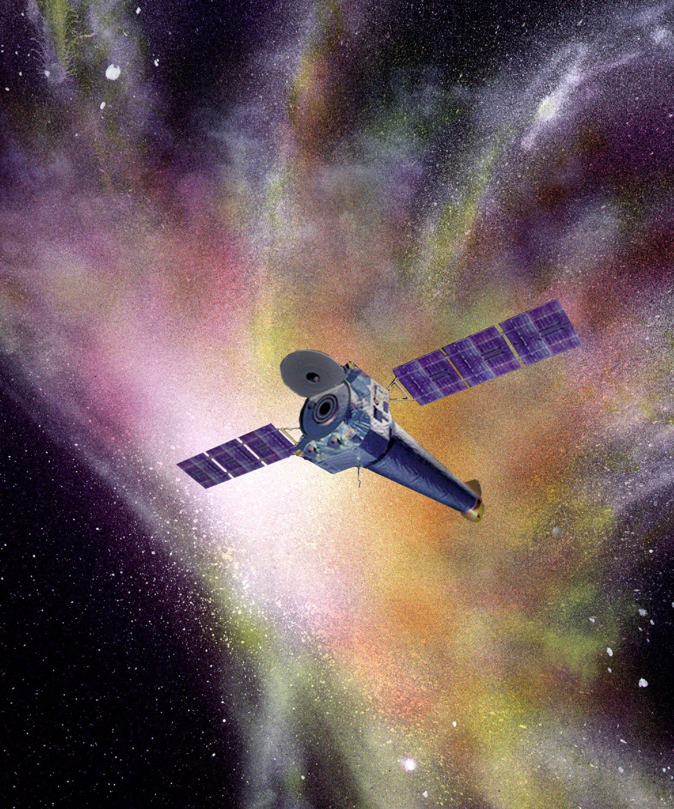
Chandra
Deep Field:
Universe
full of
black holes

Slide 30
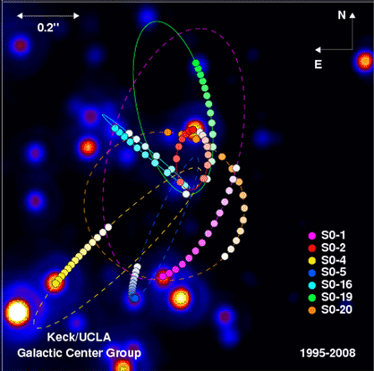
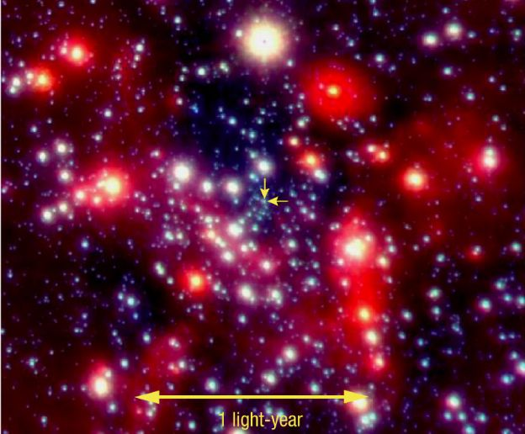
3 million solar mass black hole at center of our own Milky Way

Slide 31
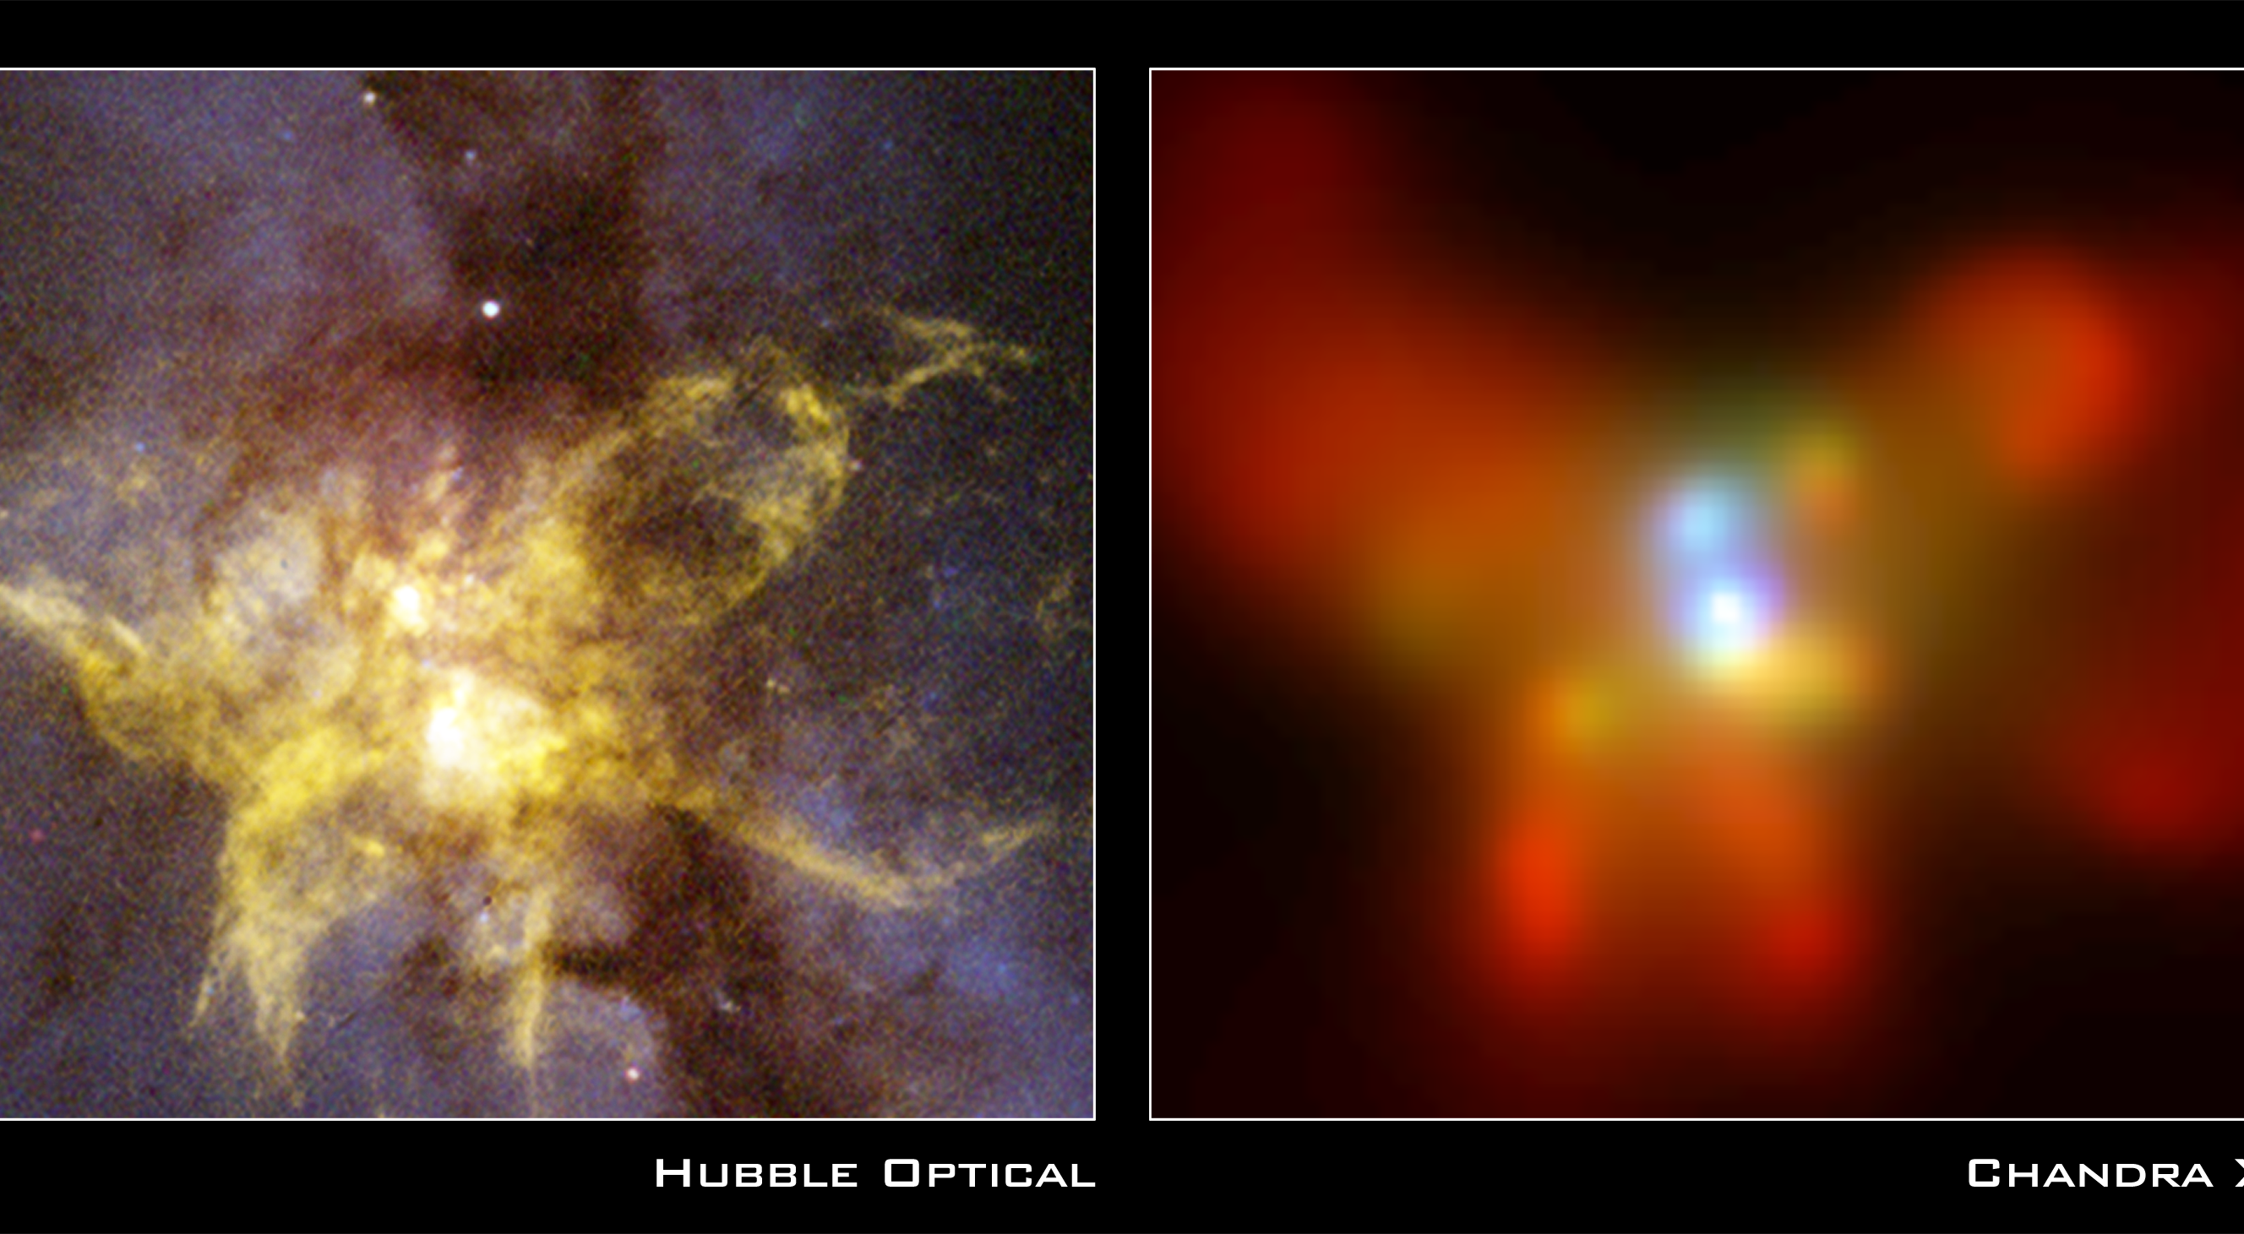
Colliding supermassive black holes

Slide 32
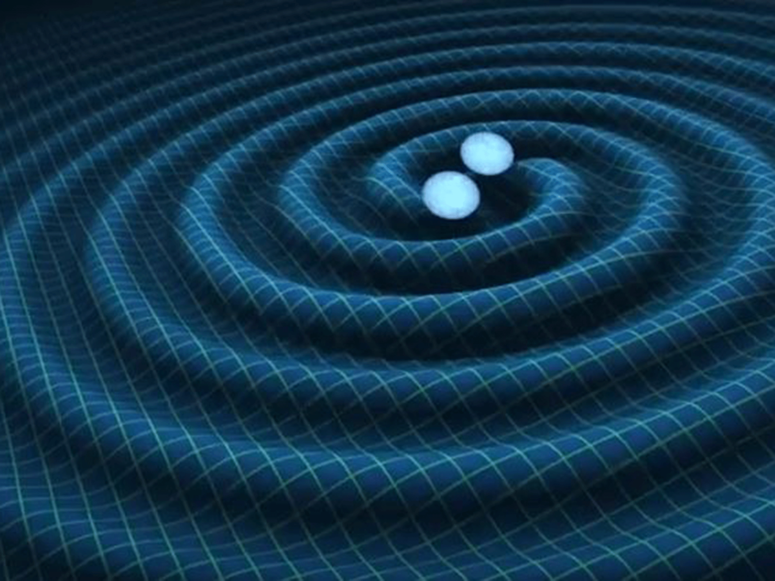
Gravitational wave = a ripple in space time that travels at c
What happens when two black holes collide? Gravitational waves!

Slide 33
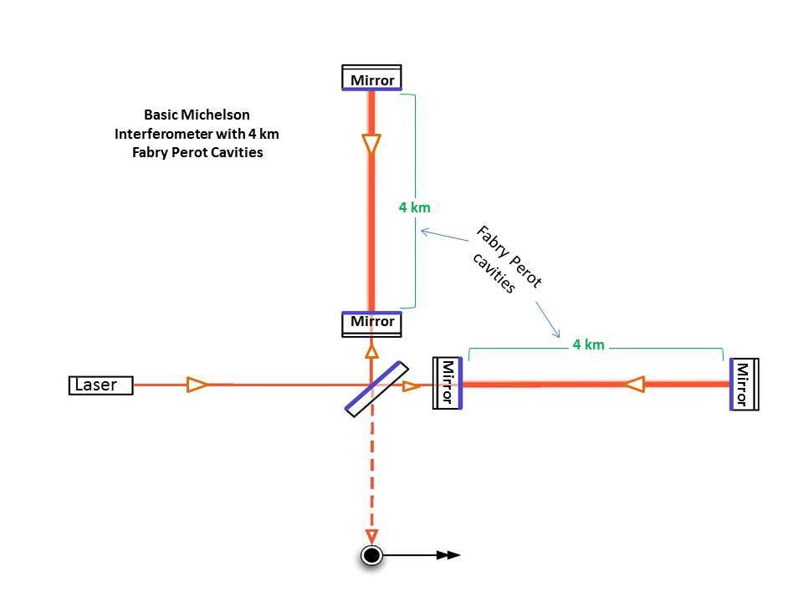
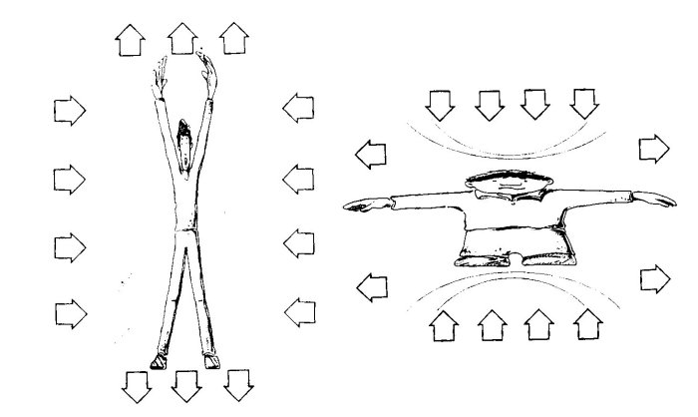
What happens when a gravitational wave passes through you?

Slide 34
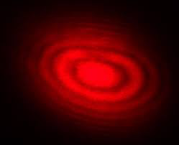
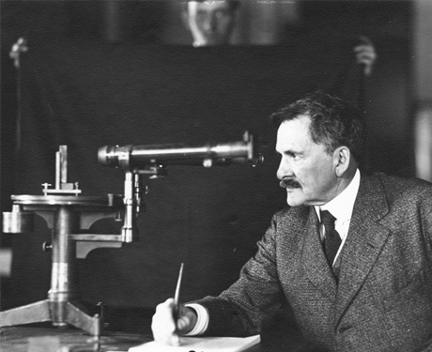
Michelson Interferometer

Slide 35
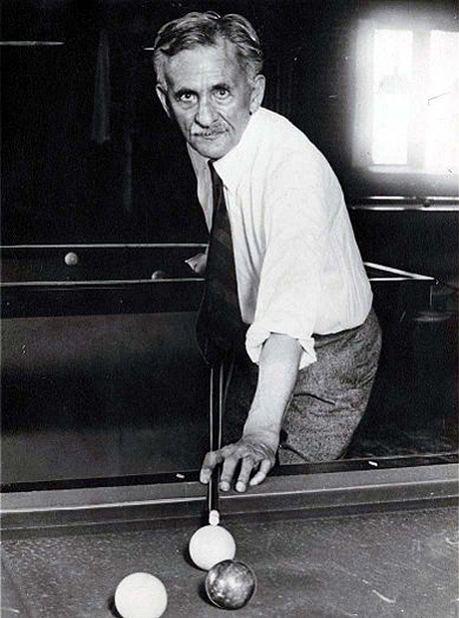

Slide 36
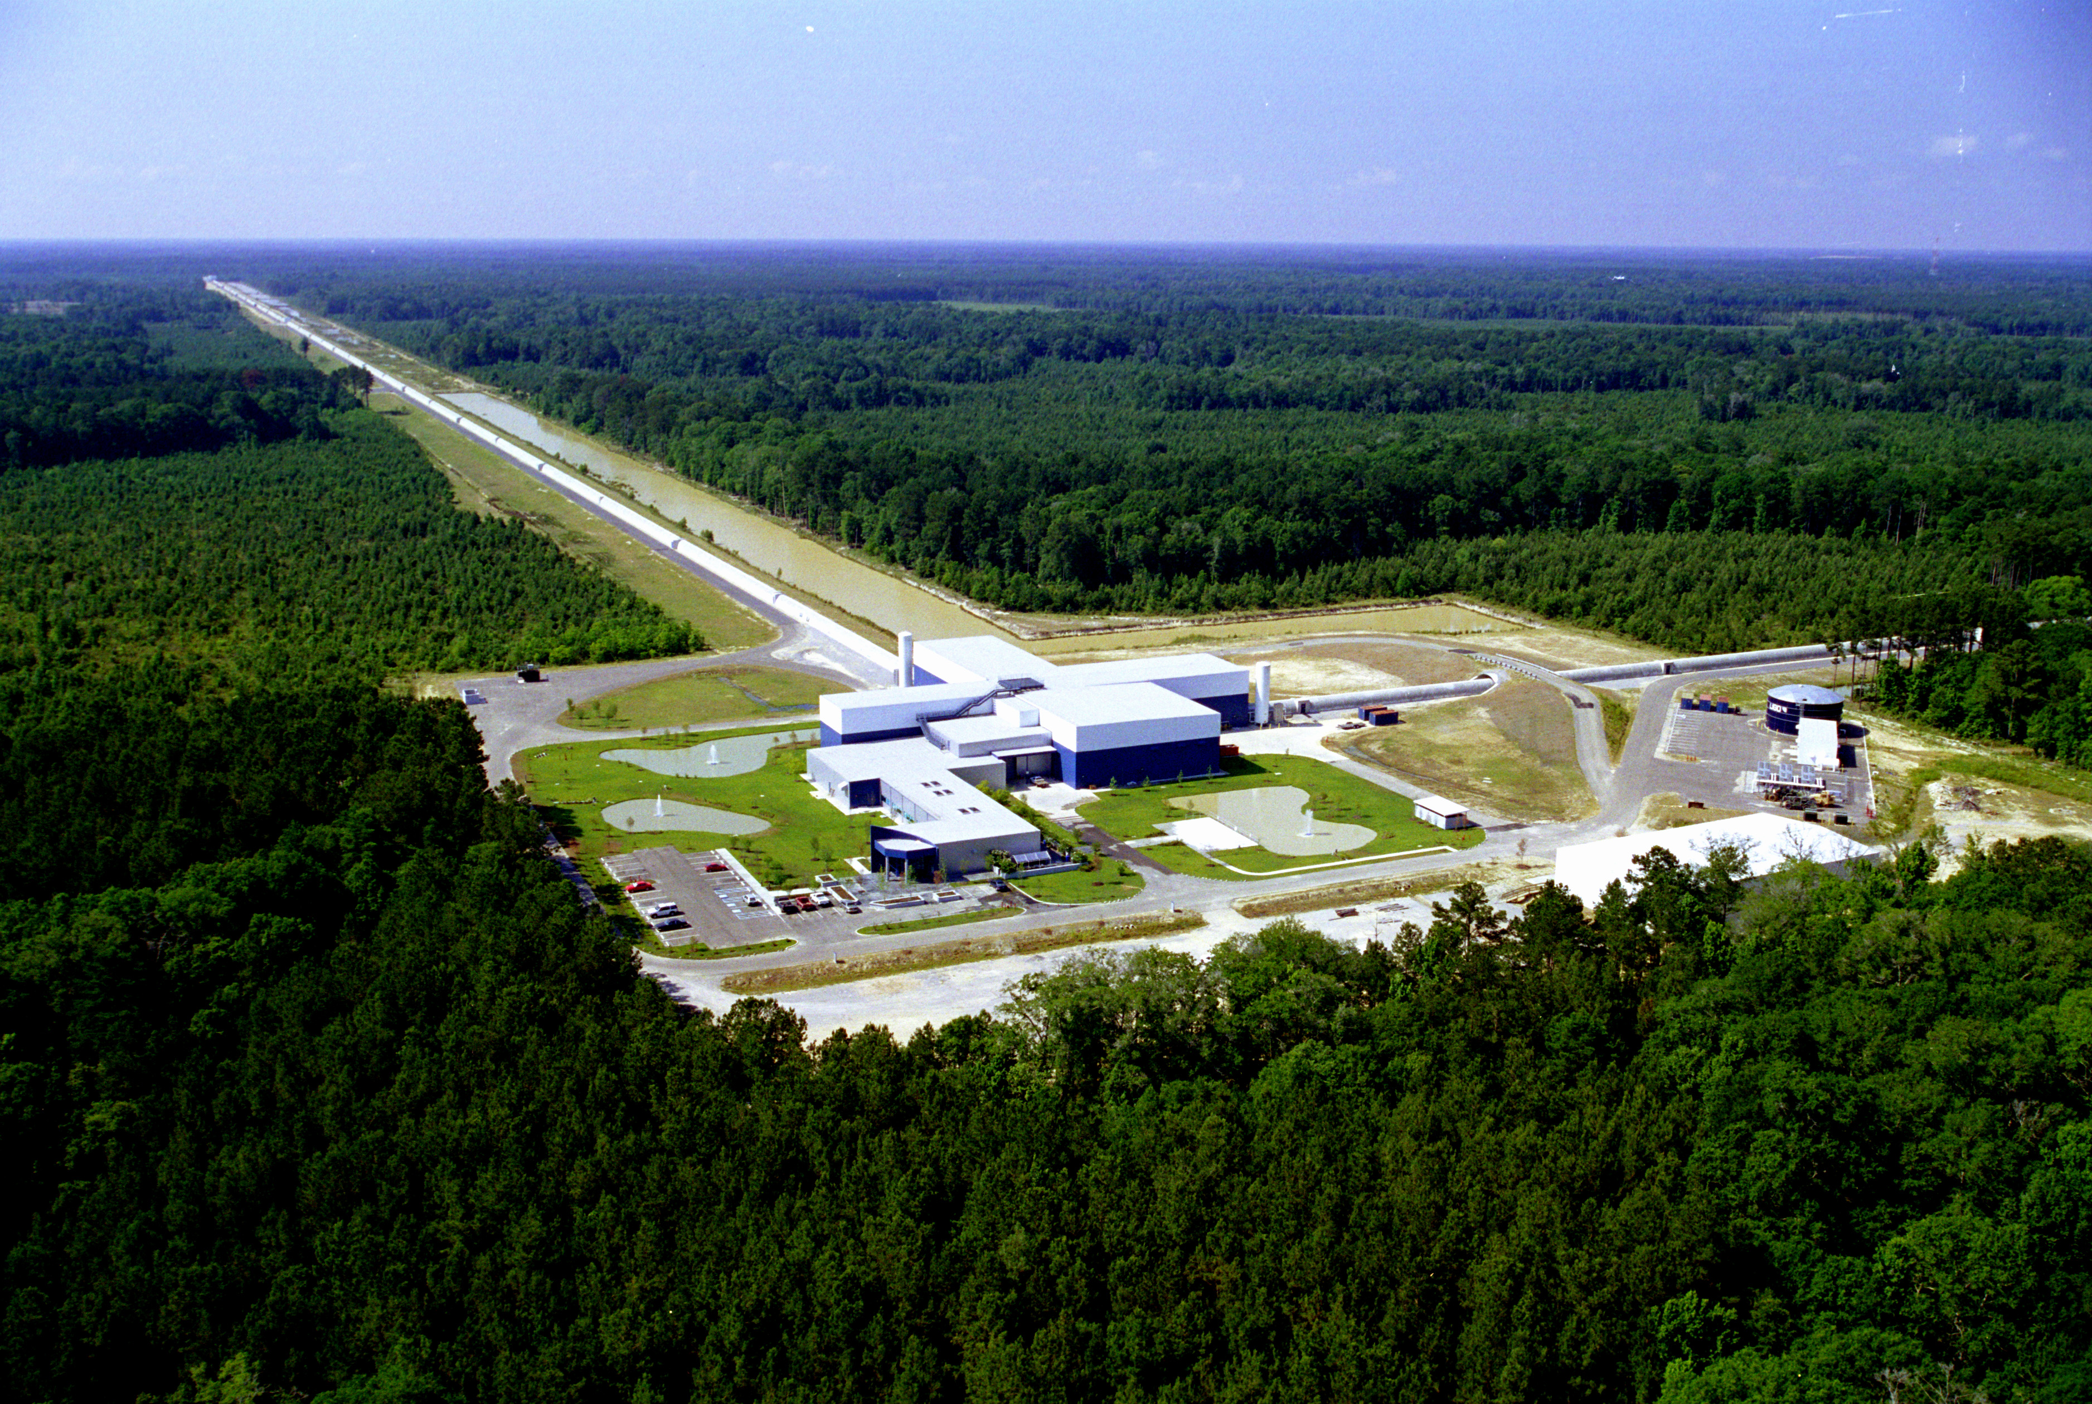
LIGO Livingston, LA

Slide 37

LIGO Hanford, WA

Slide 38
LIGOs “heard” two black holes a billion light years away merge on 14 September 2015

Slide 39


10⁻¹⁵ cm
over
4 km
7 msec earlier

Slide 40
What the LIGO’s detected
Δx = 4 x 10⁻¹⁶ cm 0.004 x size of the proton
Δx/x = 10⁻²¹, with x = 4 km
WOW!

Slide 41

Universe
is expanding and had a beginning
… Hubble, 1929

Slide 42


“Signature” of Big Bang beginning

Slide 43


Not an explosion into
space but
an explosion of space
Time warps, space stretches and
God plays dice!

Slide 47
Space expands → there is no center of the universe

Slide 48
no center – just different perspectives

Slide 49
no center – just different perspectives

Slide 50
“Einstein interprets Hubble”
Big Bang = Expansion of space
not explosive into space
No center,* different perspectives
Big Bang was everywhere.
*don’t tell people at Harvard they are not at the center of the Universe

Slide 51

Galaxy at redshift 10.7 (when the Universe was 11.7 times smaller!)

Slide 52

Cosmic microwave background: redshift 1100!

Slide 53
Einstein changed the way we think about the Universe and thereby opened our eyes to an amazing Universe.
Who will be next to do that and what new things will we see?

Slide 54



Slide 55


Slide 56
Big deal, really big deal!
Detection of gravitational waves: last big test of General Relativity
New probe of black holes
  M₁ = 29 M_{solar} , M₂ = 36 M_{solar}, M_{gw}c² = 3 M_{solar}c²
  1.3 billion light years away
New “window” to the Universe
  More events soon (probably 10’s or 100’s per year)

Slide 57


2017: VIRGO, Pisa, Italy
2018: KAGRA, Kamioka Underground Lab, Japan

Slide 58

LIGO India, 202?

Slide 59

LISA (“ligo in space”), 2034?

Slide 60


Slide 61
Some pictures from the big announcement on 11 Feb 2016
National Press Club
Washington, DC

Slide 62


Slide 63


Slide 64


Slide 65


Slide 66

Joe Weber, GW pioneer, circa 1960

Slide 67


Robert Forward, HRL
Inventor of laser interferometer

Slide 68
“Einstein interprets Hubble”
Big Bang = Expansion of space
not explosive into space
No center,* different perspectives
Big Bang was everywhere.
*don’t tell people at Harvard they are not at the center of their Universe

Slide 70


Slide 72

So, Cosmic Acceleration is caused by the repulsive gravity of dark energy
any questions?

Slide 73

We live in Einstein’s amazing Universe: much more to come, including surprises

Slide 74


The multiverse

Slide 75

What to do about the multiverse
Most important discovery since Copernicus?
Is it science? (not testable)
Many true believers (left coast) and not enough doubters

Slide 76
Dark Energy =
very elastic stuff
(p < -ρ/3) with repulsive gravity
Simplest example:
cosmological constant Λ = quantum vacuum energy (p = -ρ)
but ρ_{vac} is a little too big

Slide 77


Circa 1980: Fall of “Hadron Wall” seeds in the pudding & asymptotic freedom

Slide 78

Discovery of Cosmic Microwave Background, 1964

Slide 79





The Universe circa 380,000 yrs
WMAP
±0.001% Fluctuations

Slide 80


Slide 81


Slide 82


Slide 83


Slide 84

Making sense of the Multiverse

Slide 85


Edwin Hubble galaxies (1924) and expansion (1929)
Hubble’s law: v = H₀d
K (H₀) = 550 km/s/Mpc
Hubble & Humason (1955): few 100 galaxies, z < 0.1

Slide 86

Seeing
Back to the
Birth of
Galaxies

Slide 87
Crab Nebula (M1) rotating neutron star, 1968

Slide 88


Slide 89

Michelson Interferometer

